Slide 1
What Is Linked List?
Algorithm & Data Structure

Slide 2
Introduction
The first data structure that we’re going to implement and work with is called Linked List
It’s a list of elements called nodes that are connected or linked together in a single file

Slide 3

Linked List

Slide 4
Linked List
There are 2 types of Linked List :
Singly Linked List
Doubly Linked List

Slide 5
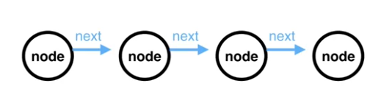
Singly Linked List
Each node only has reference to the node after it (or the next node)

Slide 6
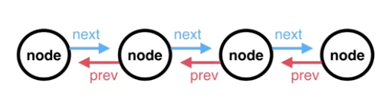
Doubly Linked List
Each node has a reference to the next node, and it also has a reference to the one before it (previous node)

Slide 7
Linked List Pointer
The Linked List itself as a whole, only needs to know about 2 nodes in the whole list for it to function correctly
It needs to know about the Head Node and the Tail Node
It keeps a reference to these nodes by 2 pointers, called Head Pointer and Tail Pointer

Slide 8
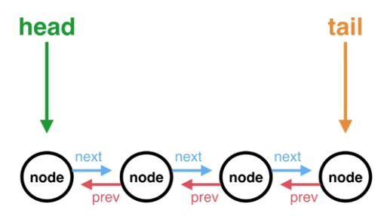
Linked List Pointer

Slide 9
Linked List Operations
To add, Read, or remove a data, Linked List have to be able to do some basic operation
The operations are :
Adding a Node to the Head
Adding a Node to the Tail
Removing the Head
Removing the Tail

Slide 10
Linked List Operations
The Head and Tail pointers change which node they are pointing to as the nodes are added or removed
They never lose reference to what the Head of the Linked List and what the Tail of the Linked List is

Slide 11
Linked List Operations
Another operation that we want to perform on Linked List is searching
We want to be able to search through Linked List to see if certain piece of data that we’re looking for actually resides in our Linked List

Slide 12
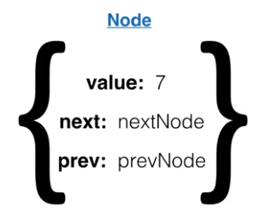
Linked List in Javascript
All of the nodes that we’ll be creating are going to be represented as Javascript Objects
For example :

Slide 13
Linked List in Javascript
It has 3 properties :
“value” property that hold the data
“next” property which references the next node in the Linked List
“previous” property that references the previous node

