Slide 1
Big-O Notation And Runtime Calculation
Algorithm & Data Structure

Slide 2
Introduction
Big-O is a notation used to classify how scalable an algorithm/function is
It allows us to estimate the worst case runtime of an algorithm
In other words, how long it takes the algorithm to complete based on the input size

Slide 3
Introduction
Big-O will informs us how much slower an algorithm will run if it’s input size grows
Let say if the array grows from 50 to 1000 elements, will the runtime of the function stay the same?
Will it proportionally larger?
Or exponentially larger?
Or the runtime change in some other way
This is what Big-O notation tells us and it describes how performant an algorithm is

Slide 4
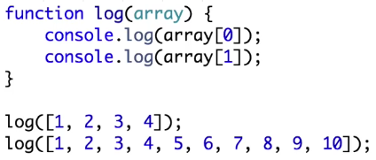
Example

Slide 5
Example
The runtime of that function is going to be constant
The runtime is constant because as the input size increases, the number of operations that we perform never changes
We still only log out the first 2 elements no matter how large the array gets
This is called Constant Runtime and is written as O (1) in Big-O Notation
Big-O Notation : “O (1)”

Slide 6
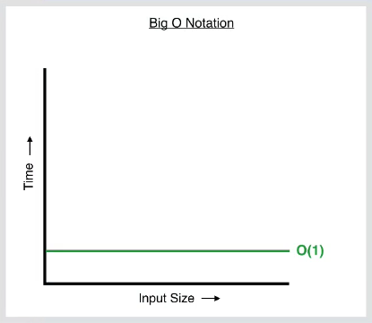
Graph

Slide 7
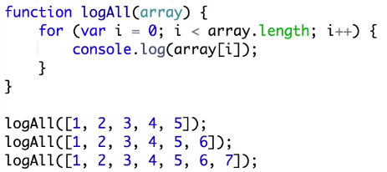
Example - Linear

Slide 8
Example - Linear
We have to do an operation on every single element in the array
As the input size increases, the runtime will also increase
For this function, the runtime will increase proportionally to how much the input increases
This is called Linear Runtime because the runtime is proportional to the input
We write it as
Big-O Notation : “O (n)”
(O stands for the function that we write. n is the input size)

Slide 9
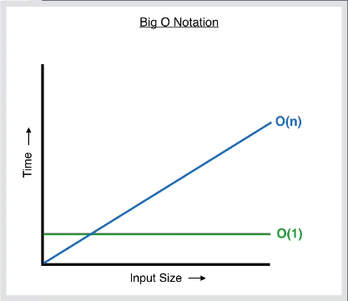
Graph

Slide 10
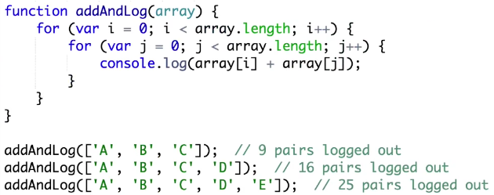
Example - Exponential

Slide 11
Example - Exponential
That function gives us every possible combination of pairs in the array
This is called Exponential Runtime
As we add one element to the input, the runtime makes an exponential jump
Big-O Notation : “O (n²)”

Slide 12
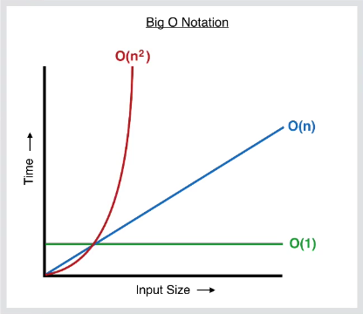
Graph

Slide 13
Example - Exponential
This kind of algorithm is not very efficient nor performant
If you write a function like this in your code, you probably won’t be able to notice the performance issues with a very small inputs
But as your inputs start to scale and become very large, a function with exponential time complexity becomes very inefficient and can slow down the app

Slide 14
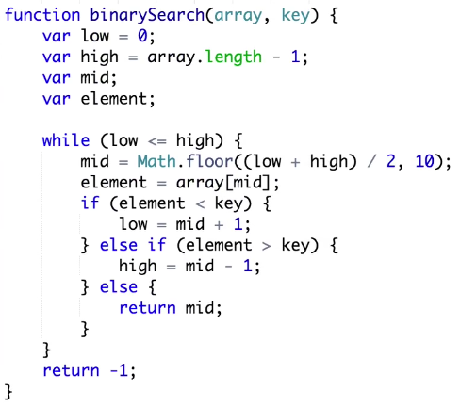
Example - Logarithmic

Slide 15
Example - Logarithmic
That algorithm is Binary Search
Binary Search has a Logarithmic Runtime, because every operation that we perform is cutting the input in half
In mathematics, the logarithm is the inverse operation to exponentiation, just as division is the inverse of multiplication
This is great because even if we have a huge input, we are only going to look at a fraction of the elements to find the value that we’re searching for

Slide 16

Example of Binary Search
Unconsciously, sometimes we use the Binary Search in our life
For example when we want to search a word in a dictionary

Slide 17
Example of Binary Search
As our input size grows, the number of operations that we will perform will not grow proportionally, but it will grow Logarithmically
If we had an input size of 4000 elements, it would only take us about 12 operations to find the element
This is really powerful and efficient

Slide 18
Example - Logarithmic
Binary Search is an example of a Logarithmic Runtime, which is written as
Big-O Notation : “O (log n)”

Slide 19
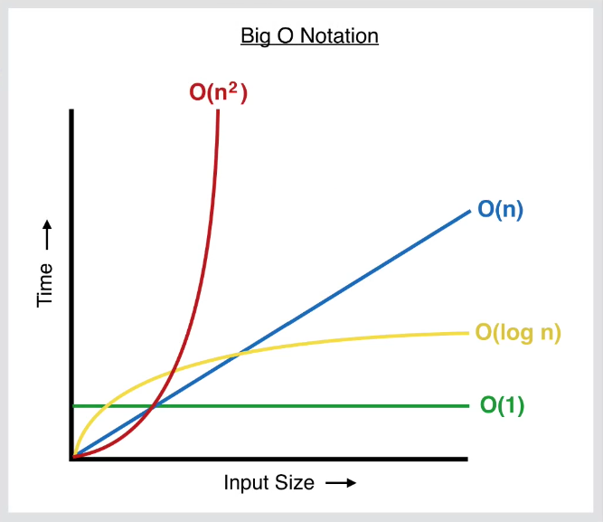
Graph

