Slide 1
Recursion
Algorithm & Data Structure

Slide 2
Introduction
Recursion is when a function calls itself

Slide 3
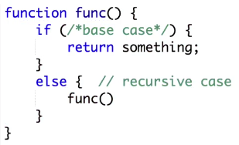
Example

Slide 4
Introduction
For the “func” function to be recursive, it have to call itself somewhere inside the function
All recursive function will have at least 2 cases inside of their code block
There’ll be a recursive case, which is where the function call itself
And there’ll be a Base case, which won’t call the recursive function, but instead just return a value

Slide 5
Example
Let’s write a function that’ll take in a number and return the factorial of that number in a recursive way

Slide 6

Factorial
Factorial of a number is simply that number times every number from itself down to 1

