Slide 1
What Is A Hash Table
Algorithm & Data Structure

Slide 2
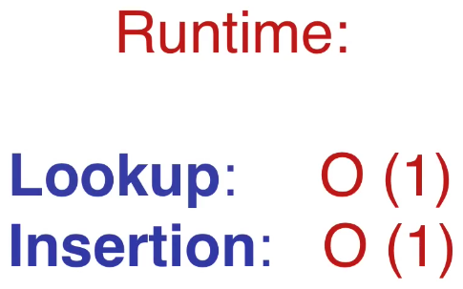
Introduction
Hash Tables are a powerful data structure because they provide us with constant time look up and insertion

Slide 3
Introduction
Hash tables are used for a wide variety of applications because they have a very fast runtime
You’ll come across different implementations of them all throughout your programming

Slide 4
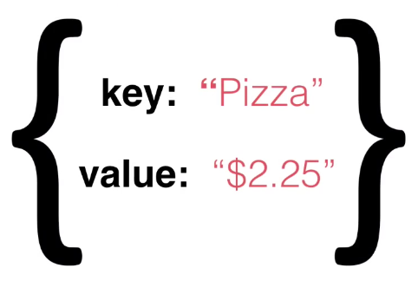
Introduction
Hash tables are used to store data that is in the form of a key associated with a value

Slide 5
Introduction
In many cases, the key will be a string and the value will be any data type

Slide 6
Implementation
Hash table is simply a table of pre-determined length in which each of the cells of the table (or bucket as we call them) holds a piece of data which has a key and a value
We’ll be using an array as our hash table
Each index of the array will be a bucket
The array will start off empty, then we’ll fill it up as we add data to it

Slide 7
