Slide 1
Fizz Buzz - Intro
Algorithm & Data Structure

Slide 2
Introduction
Fizz Buzz is an algorithm that is often asked to candidates in technical interview
It shows if we’re a good problem solver and have a solid fundamental Javascript concept

Slide 3

How It Should Work
It’ll be a function that takes in a number as a parameter

Slide 4
How It Should Work
It’ll log out to the console every number from 1 to “num”
But for each number, if the number is divisible by 3, it’ll log out the word “Fizz” instead of that number
Next, if the number is divisible by 5, it’ll log out the word “Buzz” instead of that number
And finally, if a number is divisible by both 3 and 5, we want to logout the word “FizzBuzz” instead of that number

Slide 5

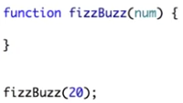
Example
If we run the function with parameter “20”, it’ll log out

