Slide 1
Harmless Ransom Note Intro
Algorithm & Data Structure

Slide 2
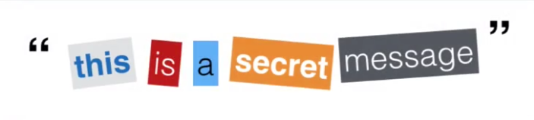
Introduction
Harmless Ransom Note is simply a note that is made from words cut out of magazine

Slide 3
Introduction
It’s an important algorithm that teach us how to do a performant search using Hash Table

Slide 4
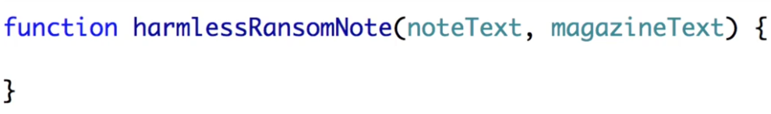
How It Should Works
Harmless Ransom Note algorithm will take 2 parameters
One will be the note that we want to write as a string
The other will be the magazine text (as a string) that we have available to make a note of

Slide 5
How It Should Works
The sole purpose of the Harmless Ransom Node algorithm is to tell us whether if we have enough words in our magazine to create our node
If we do, the algorithm will return “true”
Otherwise, it will return “false”

Slide 6
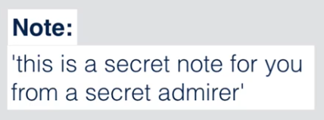
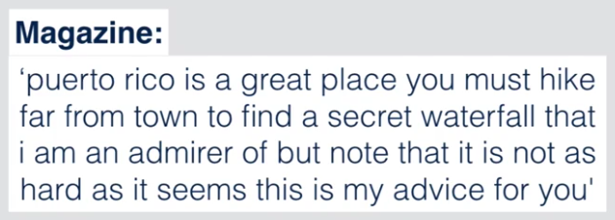
Example

Slide 7
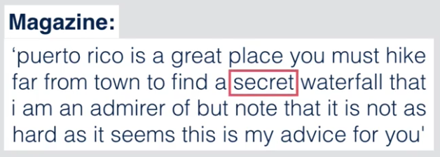
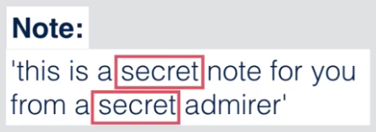
Example
In the previous example, we should get the “false” returned because the word “secret” is only found once in magazine
But we use it twice in the note

Slide 8
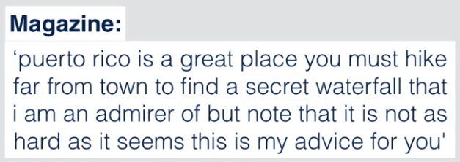
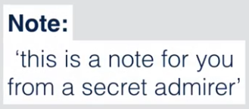
Example
And if the case is this one, the algorithm will return “true” because all the words that we need can be found in the magazine

