Slide 1
Is Palindrome - Intro
Algorithm & Data Structure

Slide 2
Introduction
Palindrome is a word or phrase that is spelled the same way both backward and forward
For example :
Race car
Madam, I’m Adam

Slide 3
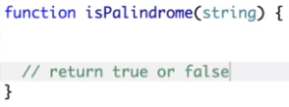
How It Should Work
This algorithm will take in a string as an argument
It’ll simply return true if the string is palindrome, otherwise return false

Slide 4
Technique
String & Array manipulation
String & Array method

Slide 5
Notice
Note that we’ll ignore any punctuation character such as commas, apostrophes, etc

