Slide 1
Mean Median Mode Intro
Algorithm & Data Structure

Slide 2
How It Should Works
This algorithm will take in an array of number as a parameter
It will return on object that has 3 properties, that is Mean, Median, and Mode

Slide 3
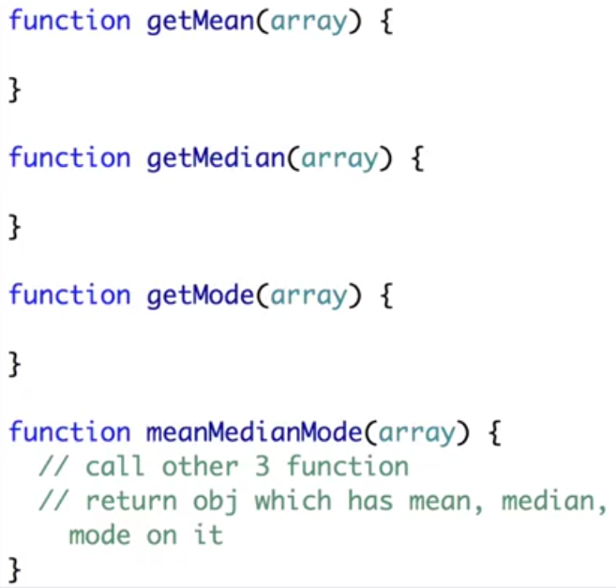
How It Should Works
To build this algorithm, we’re going to create 4 separate functions

Slide 4
Finally
Building out this algorithm will teach you some techniques for performing math calculation
It’ll also teach you the importance of “functional programming”

Slide 5
Finally
Functional Programming is the practice of breaking down your algorithms and code into separate functions
These separate functions can be re-used in multiple different places
You don’t have to keep rewriting the same code

