Slide 1
What Is A Binary Search Tree
Algorithm & Data Structure

Slide 2
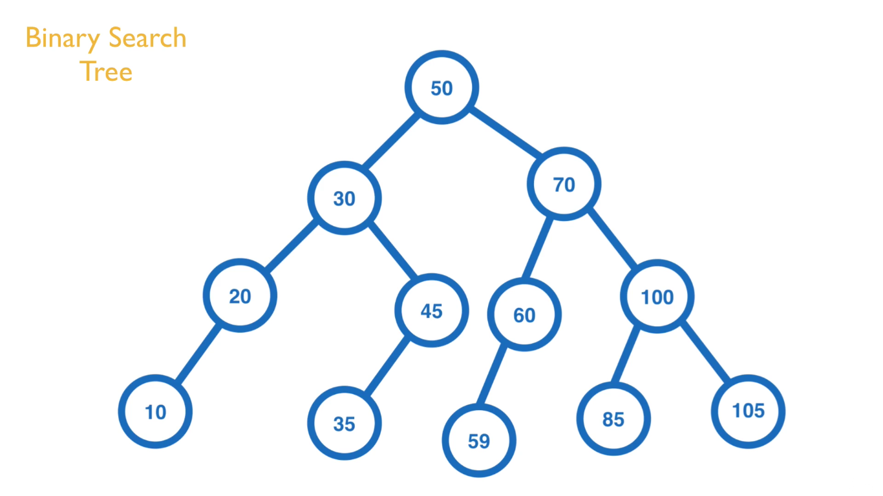

Slide 3
Introduction
Binary Search Tree is a collection of nodes that are all connected together in a certain way
Each node in Binary Search Tree will have up to 2 child nodes, that is Left Node and Right Node
Each node will contain some data or value similar to Linked List

Slide 4
Introduction
In this section we’ll focus solely on Binary Search Tree that take in numbers as a value
But of course you can make BST that holds any data type as a value if you want it to
The way the BST works is that all of the left nodes will be of lesser or equal value to their parent node
And all of the right nodes will be of greater value than their parent node

Slide 5
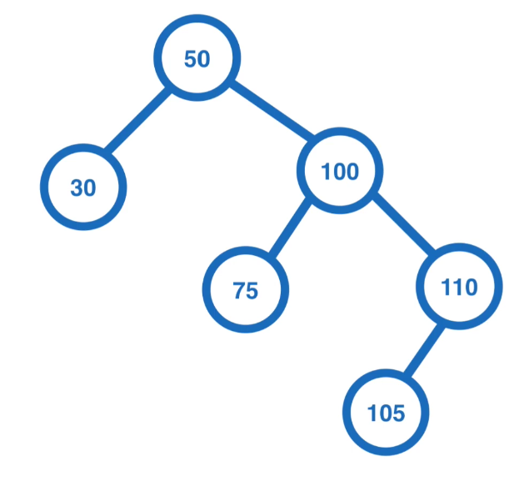
Example

Slide 6
Clarification
One thing we’re going to change is calling all the elements as node
Instead we’re going to make each of those elements it’s own Binary Search Tree

Slide 7
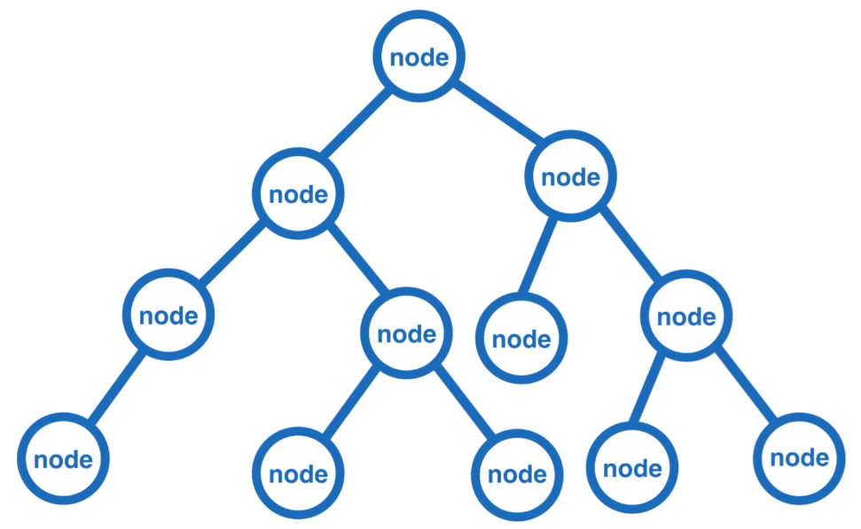
Before

Slide 8
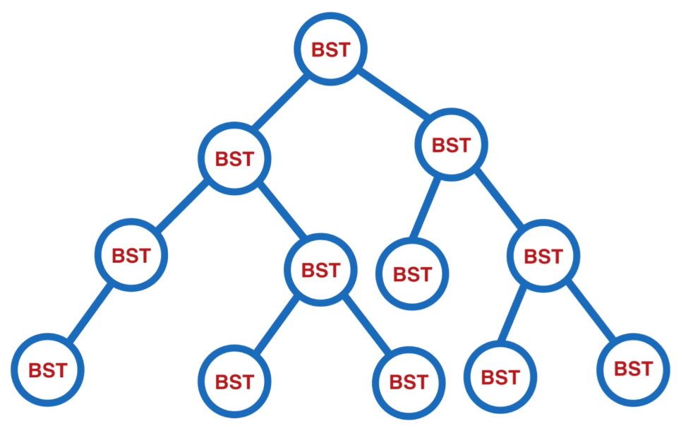
After

Slide 9
Explanation
Each node in our tree is basically a subtree
It itself is a root node with up to 2 children nodes, which makes it a Binary Search Tree

Slide 10
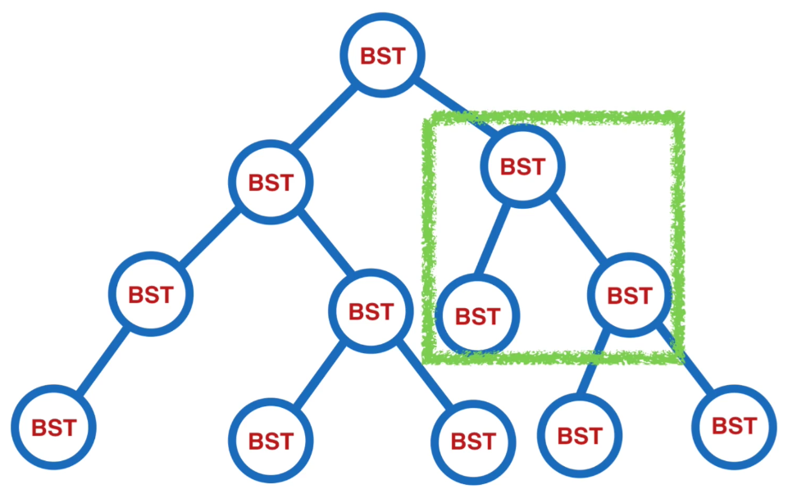
Explanation

Slide 11
Functionality
The functionality that we want to put on our BST is Inserting value into it, which is essentially be like Adding a new BST to the root BST

Slide 12
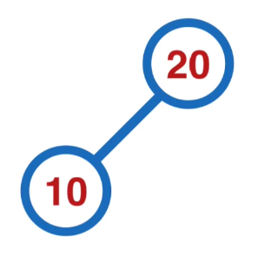
Example

Slide 13
Functionality
We’ll also want to have a method in our BST that take in some value and tell us if that value is in the BST or not
We’ll also want a Depth First Traversal method and Breath First Traversal method on our BST
Each of which are simply a ways of traveling through the tree and touching every node
The difference between these 2 methods is what pattern we traverse the tree

Slide 14
Functionality
In Depth First Traversal, we’ll start at the top and follow each branch all the way to it’s down
In Breadth First Traversal, we’ll also start at the top, but we’ll go across each level before moving down to the next level

Slide 15
Functionality
As we touch each node in the tree, we’ll be running some function on each of them
In our case, we’ll simply log out the value of each node
But you can of course perform whatever function you want to on them

Slide 16
Foreword
Finally, before we start coding our BST, we need to cover an important topic, that is Recursion, because BST is a very recursive structures by the nature

