Slide 1
Binary Search Tree Wrap Up
Algorithm & Data Structure

Slide 2
Use Case
Binary Search Tree and variation of them are used very often to store data
As the name imply, they are very fast to search through and retrieved data from
In fact, it is also a very quick process to insert and delete data from a binary search tree
The reason for this is that all of these methods are basically implementing the binary search algorithm

Slide 3
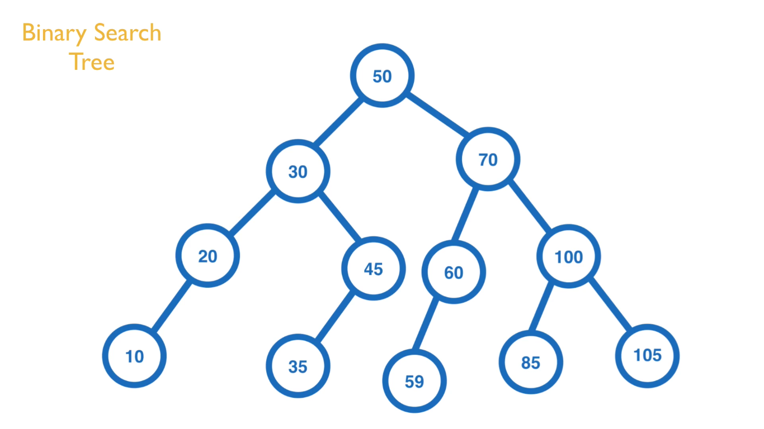

Slide 4
Search
If you’re looking for a value in a BST, you’ll start at the root node and loop through it’s child
With every loop you take through a child node, you’re throwing away other half (child) of the nodes in the tree
So you don’t have to search every node in the tree

Slide 5
Search
In a balanced-BST of 4000 nodes, it only takes about 12 steps to find the node that you’re looking for
This is called Logarithmic Runtime “O (log n)”
This is faster than the runtime of Linked List which is “O (n)” for searching

Slide 6
Notice
One important thing to note is that BST are only this performant when they are balanced
To have a balanced BST is to have all (or most) nodes to have a left and right child, so you have a full tree
In some strange cases, depending on the data you’re using, you could wind up with every node only having a right child for example

Slide 7
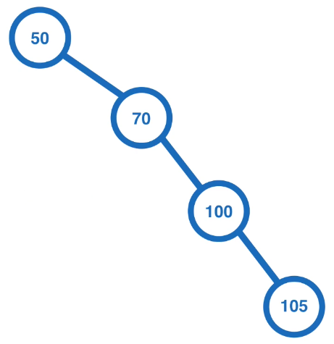
Notice

Slide 8
Notice
In that case you would essentially end up with a Linked List structure
You would have to search through every node just to find the one you’re looking for
So it’s important to remember that BST are most performant when they are balanced

Slide 9
Use Case
Anything in which you may perform Binary Search algorithm
For example :
Dictionary
Phone Book
User with numerical ID
etc

