Slide 1
Hash Table Wrap Up
Algorithm & Data Structure

Slide 2
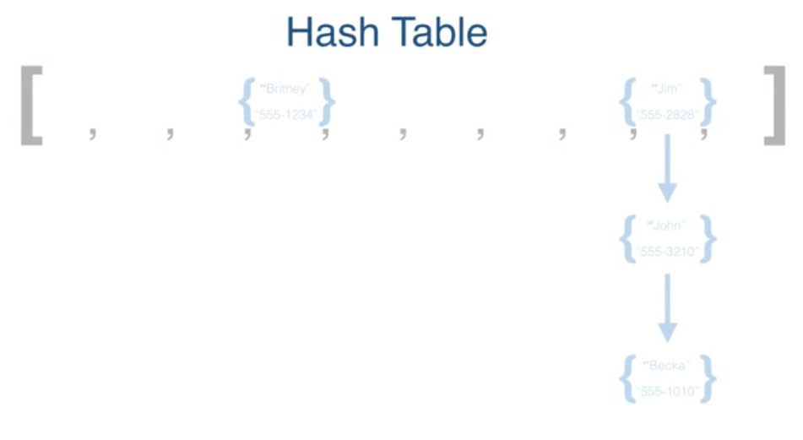

Slide 3
Introduction
Hash Tables are an incredibly performant data structure
They have Constant time Insertion and Lookup
Big-O Notation : “O (1)”

Slide 4
Practical Use
Email provider storing addresses
User of an application
etc

Slide 5
Cons
The insertion of data is done in somewhat of a random way determined by the hashing function
Data doesn’t store references to other pieces of data in the data structure unlike Linked List or BST

