Slide 1
Facebook Authentication Flow
Mobile Developer Fast Track

Slide 2
Introduction
Now the user has the ability to navigate away from the Welcome Screen
Next we need to think about what happens when they go to the Auth Screen
So this is where we’re going to start figuring out how to handle Facebook Authentication using Expo

Slide 3
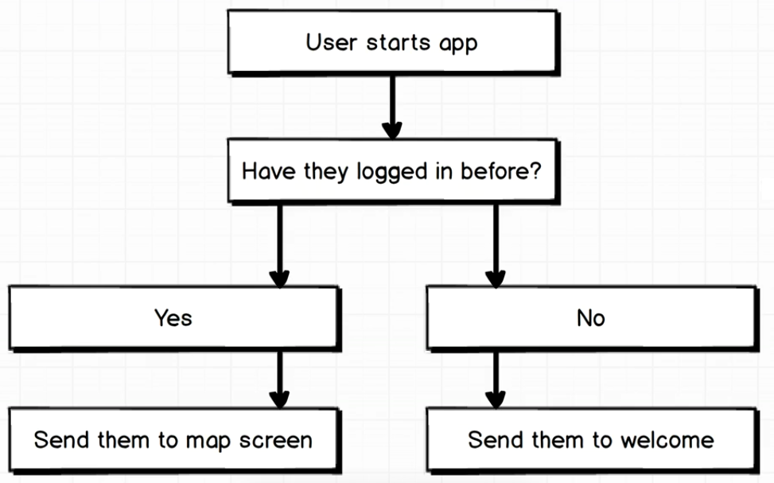
Authentication Flow

Slide 4
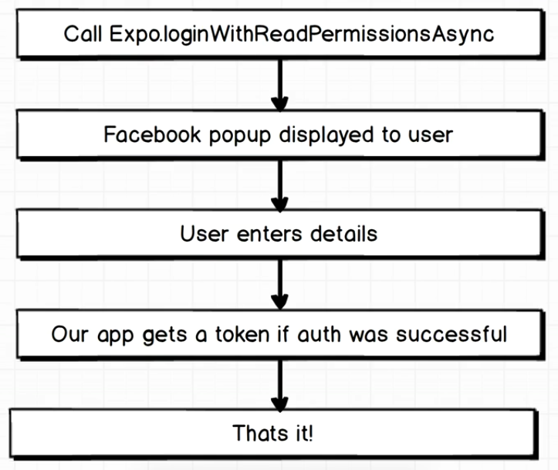
Facebook Login Flow

Slide 5
Facebook Login
Before we code, we have to register our app to get permission to use the Facebook API
There’ll be a little bit setup on the Facebook side of things
But it is one time setup, we’ll have to do it just once

Slide 6
Facebook Login With Expo
The reason that Expo is fantastic with using Facebook is that there is a lot of behind-the-scene setup that is going to be handled by Expo for us

Slide 7
Facebook Login With Expo
To learn more on how to use Expo to log in to Facebook, visit
https://docs.expo.io/versions/latest/sdk/facebook.html
Please follow those steps before we go to the next section

