Slide 1
Redux Setup
Mobile Developer Fast Track

Slide 2
Introduction
In the last section we started setting up our app for the Facebook Authentication
At the very end, there was going to be a critical piece of state/data we got from the Facebook authentication process
That is the Token

Slide 3
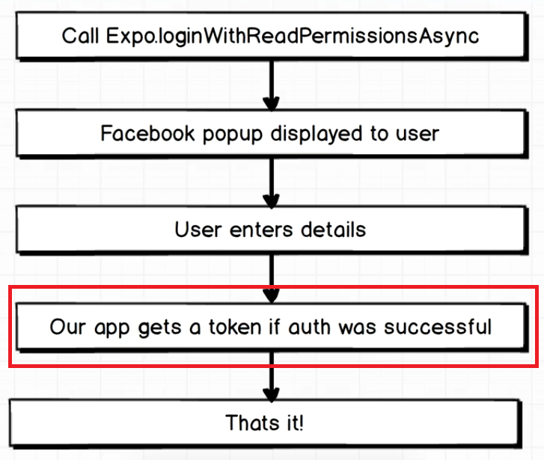
Introduction

Slide 4
Introduction
The presence of the token means that the user is successfully signed in
This token will be used in all over the place in our app
If we talk about the “centralized data”, we’ll started to think about Redux immediately

Slide 5
Introduction
We’re going to add Redux into our app
We’re going to use Redux to maintain the token and notify different components that the token does/doesn’t exist

Slide 6
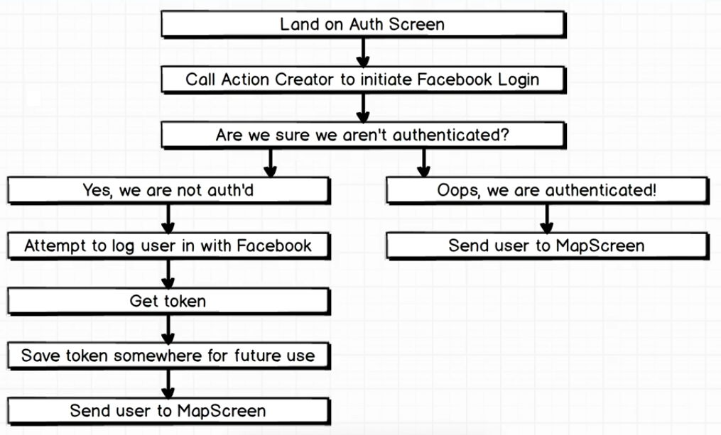
Facebook Flow Inside The App

Slide 7
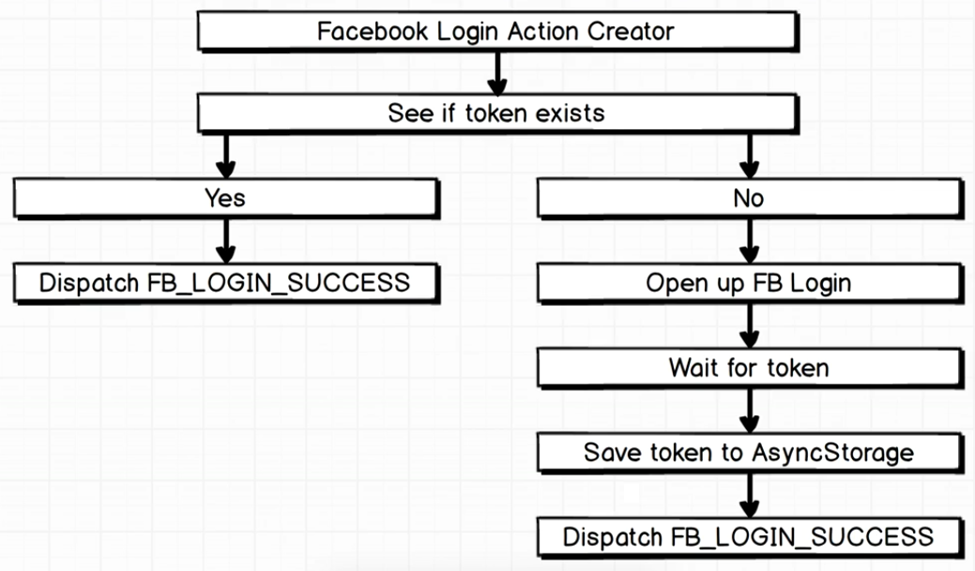
Facebook Login Action Creator

Slide 8
Redux Setup
Before we code, we have to install some npm modules, that is
redux
react-redux
redux-thunk
npm install --save redux react-redux redux-thunk

