Slide 1
Creating React Native Apps
Mobile Developer Fast Track

Slide 2
Introduction
As far as the official documentation is concerned, the best way of getting started with React Native is by installing the React Native CLI and using it to generate a new project
However a lot of stuff has changed
Now we have a couple of different options available for getting started with React Native

Slide 3
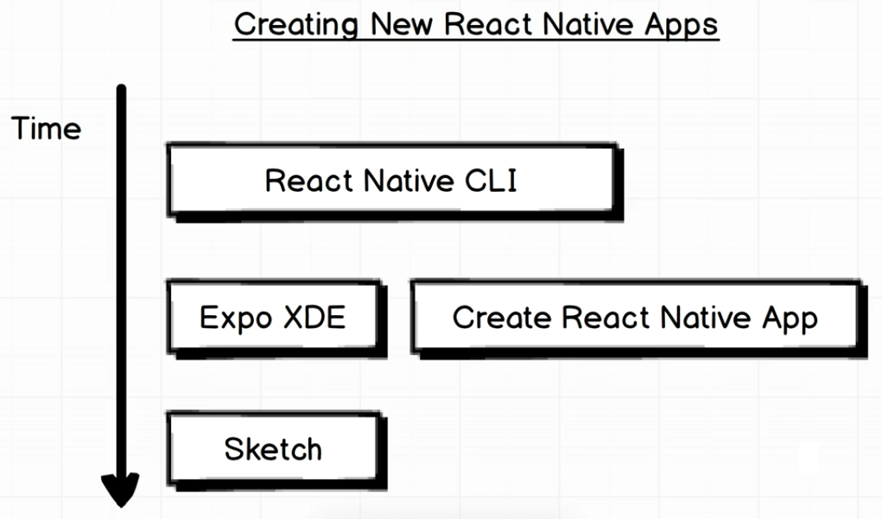
The Option

Slide 4
React Native CLI
Using React Native CLI requires you to install XCode (on MacOS) or Android Studio (on Windows)
For some people, those installation was a little bit of a headache, especially setting up an Android

Slide 5
Expo XDE
Download Expo XDE from
https://expo.io/tools
WARNING:
Currently the latest npm version (as in this course, 5.5.1), isn’t fully compatible with Expo
It is recommended that you have to downgrade your npm to the version 4.6.1

Slide 6
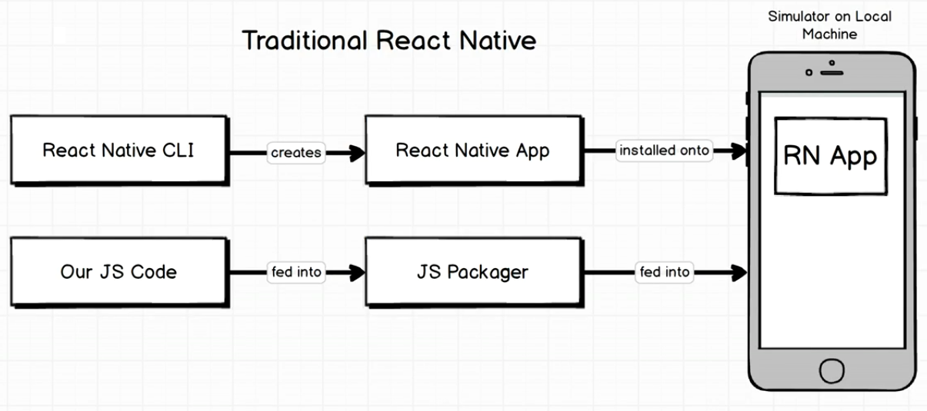
Traditional RN CLI

Slide 7
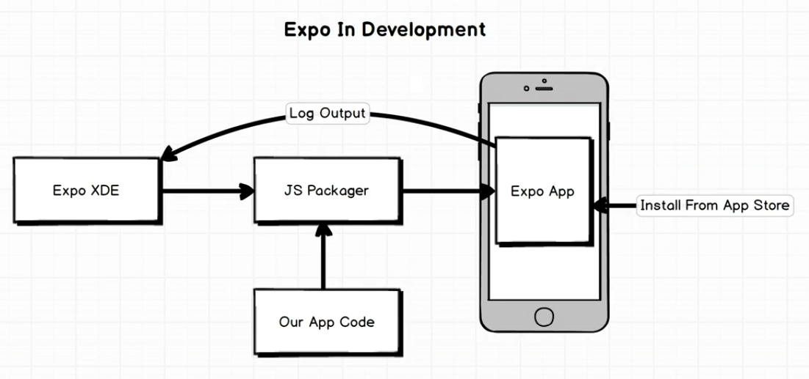
Expo XDE

Slide 8
Expo XDE
Expo helps you run your app on the actual device
It also gives a lot of added benefit

Slide 9
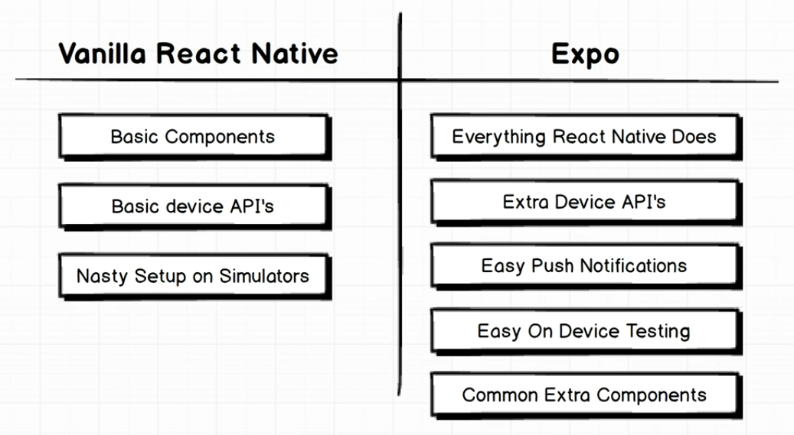
Expo XDE

