Slide 1
Creating Our First Apps
Mobile Developer Fast Track

Slide 2
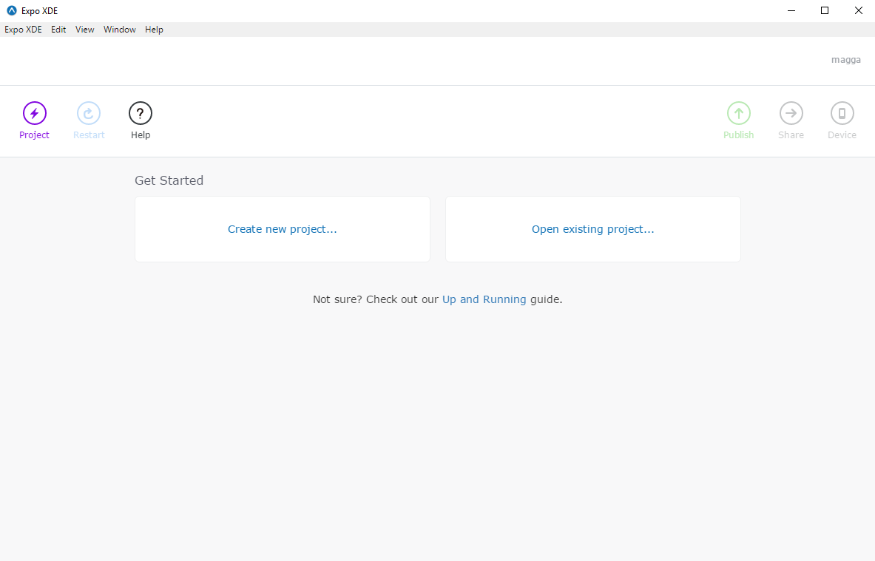
Expo XDE

Slide 3
Expo XDE
To create a new project, on the left hand side, click on the project button and then select “New Project”

Slide 4
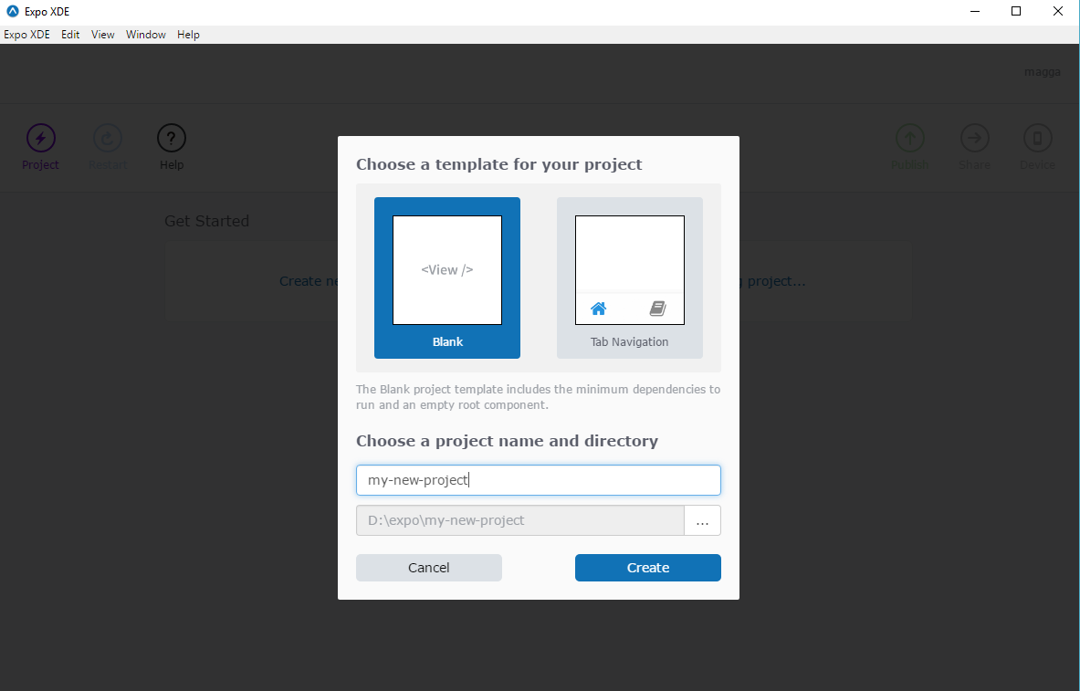
Expo XDE

Slide 5
Expo XDE
Select a new “Blank” project
Rename the project and select the location where you want to save the project
Click the “Create” button

Slide 6
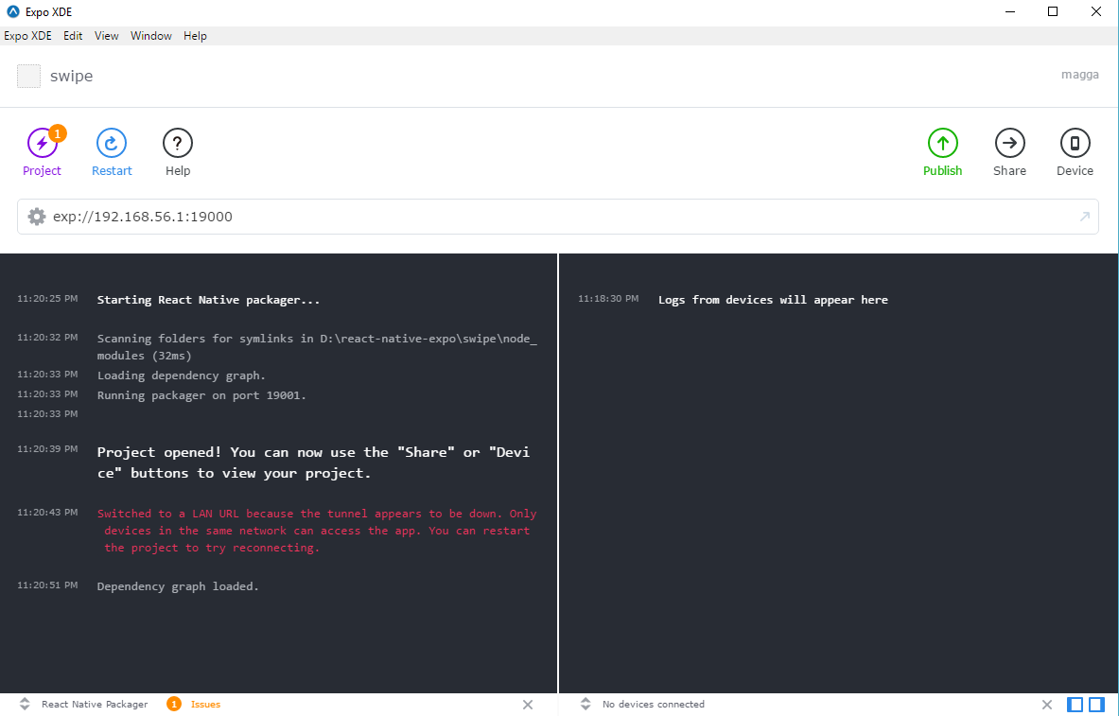
Expo XDE

Slide 7
Expo XDE
To run your app on the real device, first install the Expo App on the respecting mobile operating system
Android
https://play.google.com/store/apps/details?id=host.exp.exponent
iOS
https://itunes.apple.com/app/apple-store/id982107779

Slide 8
Expo XDE
Once you’ve installed the app on the device, it’s pretty easy to run the app on the phone
On the right hand side, click “Share” button and then scan the QR Code on the Expo app’s on your mobile device
Or alternatively, you can run the app on the (android/ios) simulator by hitting the “Device” button

