Slide 1
Animation System
Mobile Developer Fast Track

Slide 2
Introduction
Animation, in application, is how do you get stuff to move around on the screen as the user interacts with our app
For the first app here, we’re going to focus only on a single component that’s going to use animations in a very big way
We’re going to make just a component that’s going to demo how animations work with React Native

Slide 3
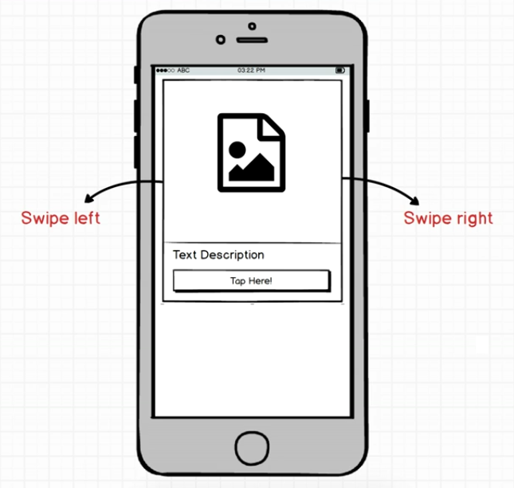
The App

Slide 4
The App
We’re going to make a Tinder (dating app) Card
A Tinder Card is intended to have an image at the top, some text, and a button
And the most interesting part, is the animations that are tied to it

Slide 5
The App
The user should be able to use their finger to swipe the card to the right or left
The other key things is that as a user starts to swipe the card, we also want to rotate the card at the same time

Slide 6
The App
We’ll talk about the API that the component itself will have
There are 2 different systems of animation with React Native that available to us

Slide 7
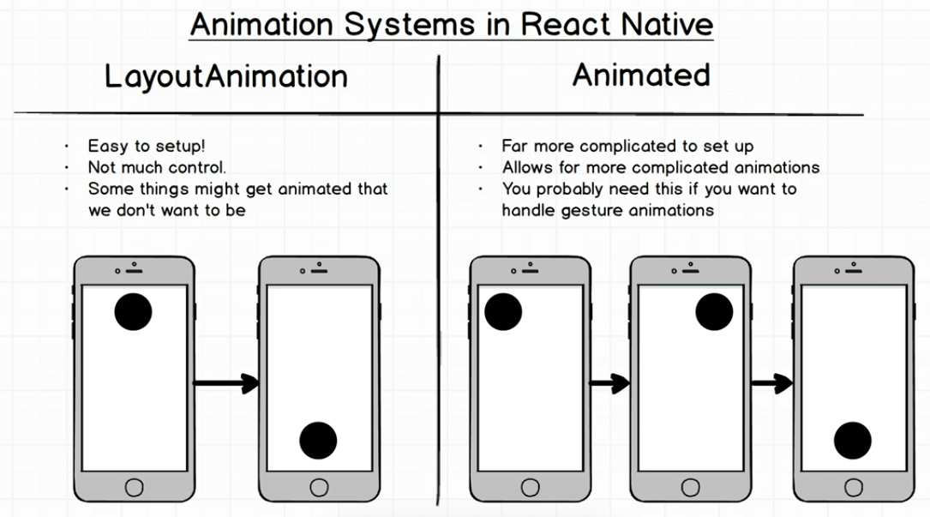
Animation System

Slide 8
Animated
The Animated module contains many different function, object, and component that we can use to set up animation
There’s a lot of code and properties that sit inside of this module

Slide 9
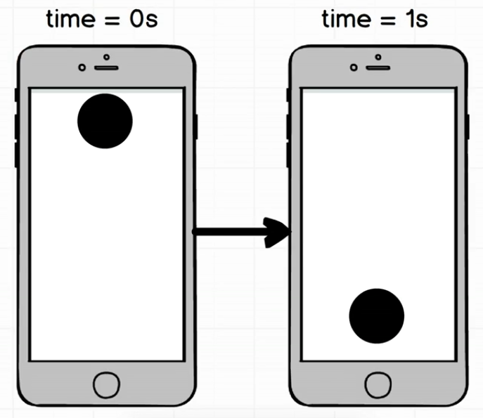
Animated Example

Slide 10
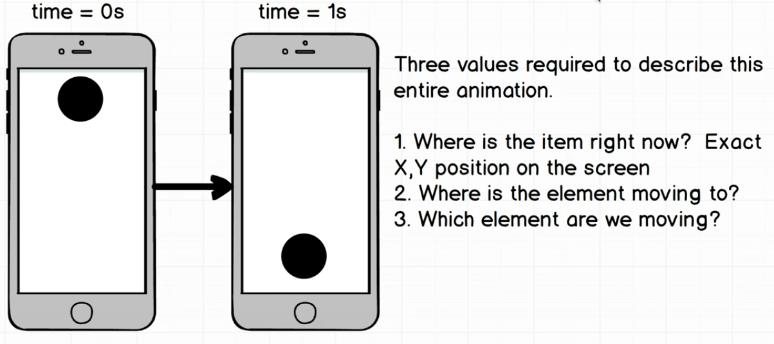
Animated Example

Slide 11
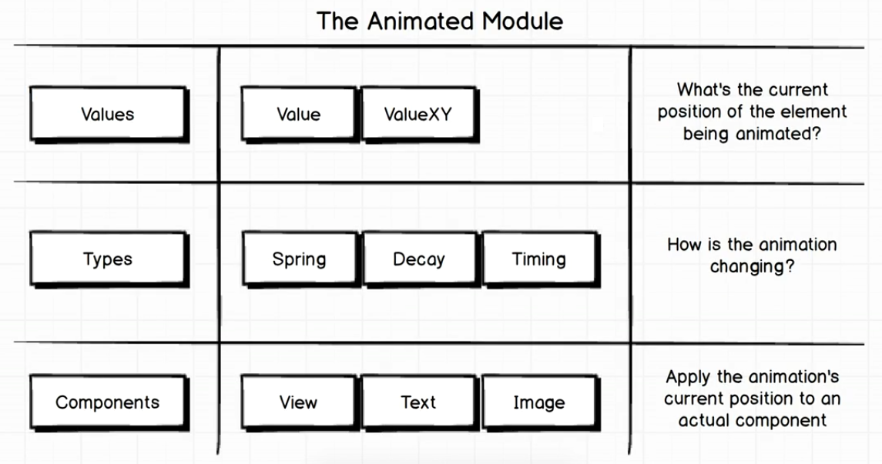
The Animated Module

