Slide 1
Animation From Scratch
Mobile Developer Fast Track

Slide 2
Introduction
To get started, let’s build a very simple animation

Slide 3
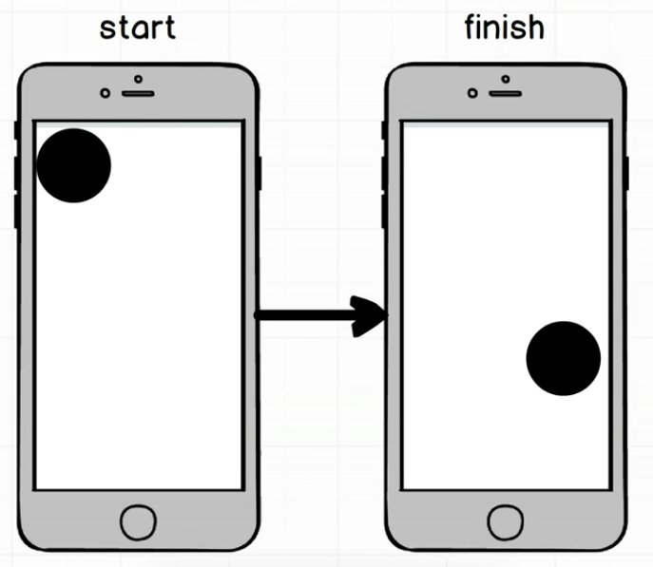
Introduction

Slide 4
Introduction
To make this happened, we’re going to use the Animated module
We’re going to ask the 3 questions about this animation
What element are we trying to animate?
How’s the ball changing over time?
What is the end goal of the ball?

