Slide 1
Animation From Another Angle
Mobile Developer Fast Track

Slide 2
Introduction
There’s a little glitches on animation in React Native
To know that, let’s review how we do an update to a component

Slide 3
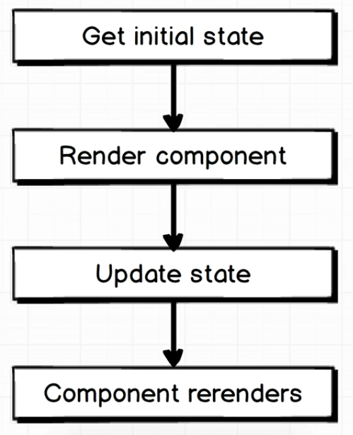
State Update

Slide 4
State Update
That is the process that we use in every single aspect of React Native right now to get a component to update (with or without Redux)

Slide 5
Gotchas
But with the Animated module that we have written previously, there’s no reference to the State yet
And yet, we have successfully update the component

Slide 6
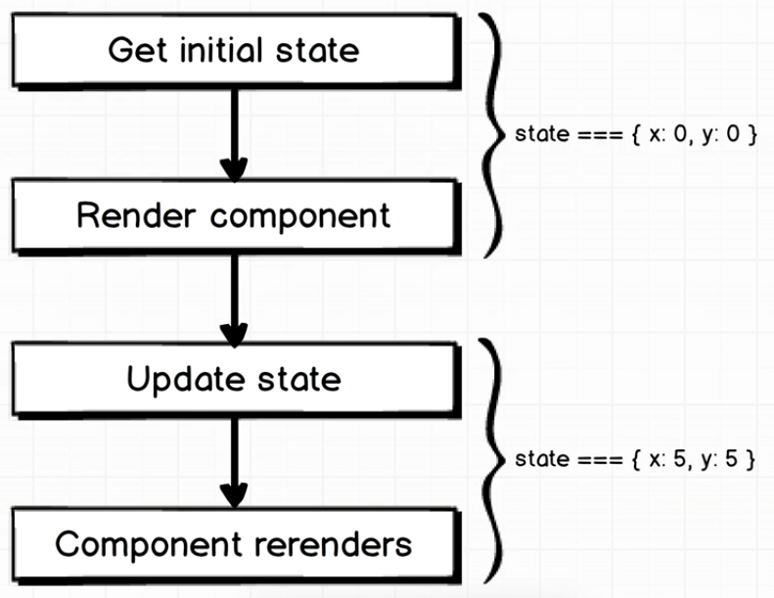
Gotchas
We may assume that this is what happened now :

Slide 7
Gotchas
That is absolutely NOT how we handle animation with React Native
We do NOT somehow store those values (x: 0, y: 0) on State and then call setState() to make a component move around on the screen
The animation system that we use runs completely outside of that system

Slide 8
Gotchas
Inside of all the animation that we just setup before, the render() function is only going to run exactly one time
It’s the Animated.View that’s going to run the whole animation ever re-rendering the component

Slide 9
Conclusion
The animated system runs completely outside of the State system that we’re used to build

Slide 10
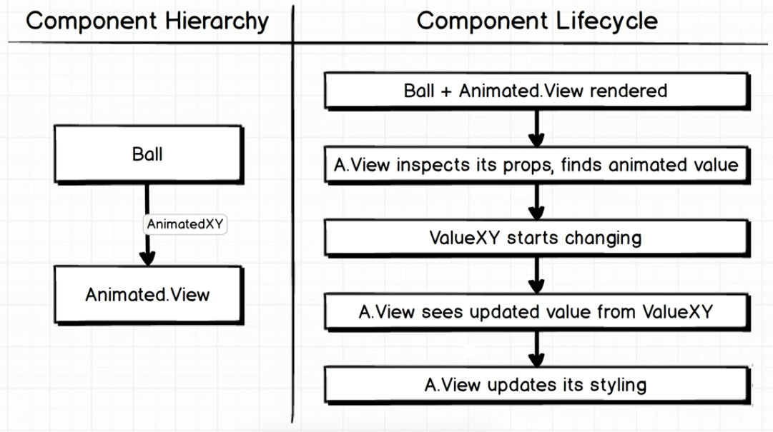
Conclusion

