Slide 1
The Pan Responder System
Mobile Developer Fast Track

Slide 2
Introduction
In the last section we put together a markup around our Card component
We get something a much nicer appearing on the screen
However we’ve spent a lot of time not talking much about animation

Slide 3
Handling User Press
First thing, we have to figuring out how to handling a user clicking, pressing, or dragging on an individual card on the screen
In doing so, we’re not only using the animated module
We’re going to be using another module from React Native called PanResponder

Slide 4
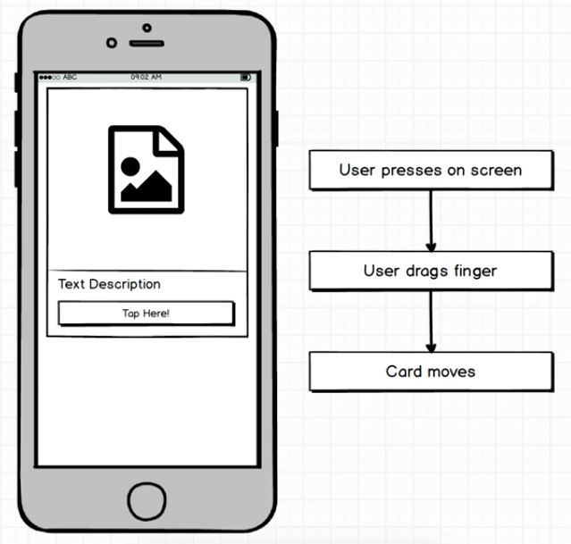
Handling User Press

Slide 5
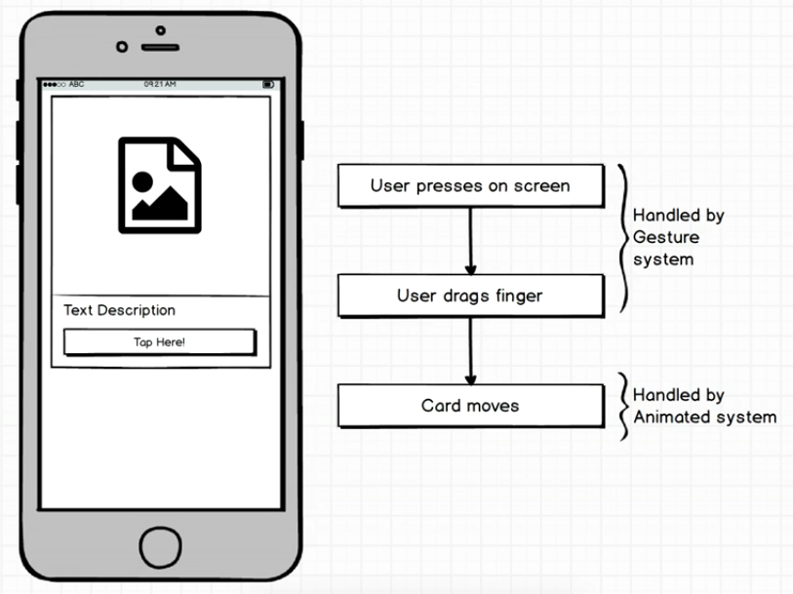
Handling User Press

Slide 6
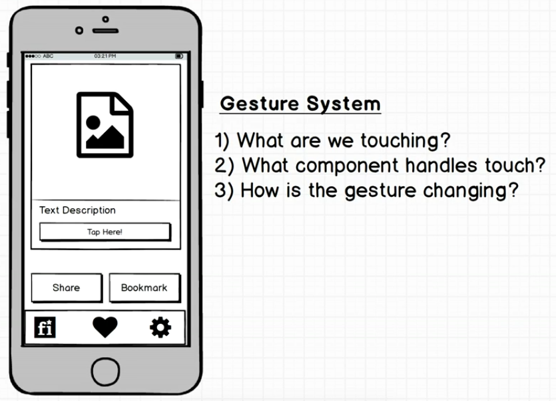
Gesture System

