Slide 1
Transitioning To React Native
Mobile Developer Fast Track

Slide 2
Introduction
In the previous section, we’ve successfully made a full-working Google Cloud Function to handle the verification
We’ve successfully tested it on Postman
Now in this section, we will handle the React Native side

Slide 3
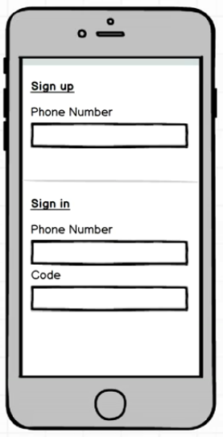
Mockup

Slide 4
The App
We’ll build just a single form
We won’t using Redux or anything like that, just a pure React Native
The goal of this section is just to show how to sign in to Firebase using JSON Web Token

Slide 5
The App
So for now, just create a new React Native app and we’re ready to go

