Slide 1
Using Async Storage
Mobile Developer Fast Track

Slide 2
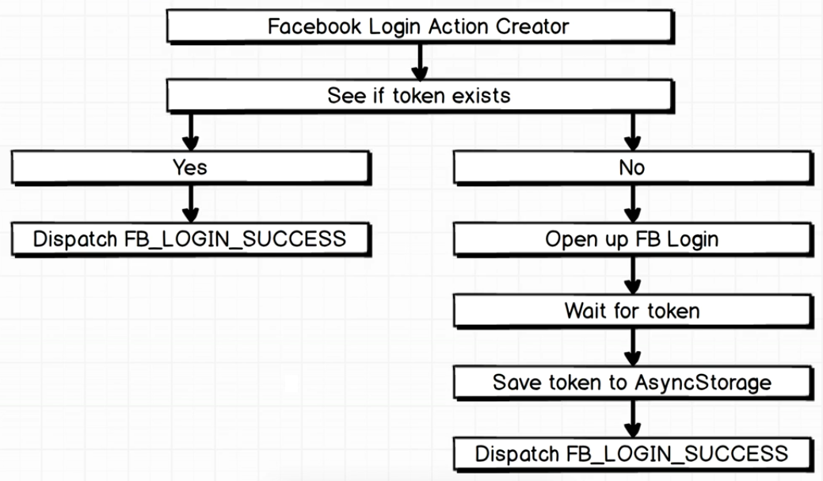
Authentication Flow

Slide 3
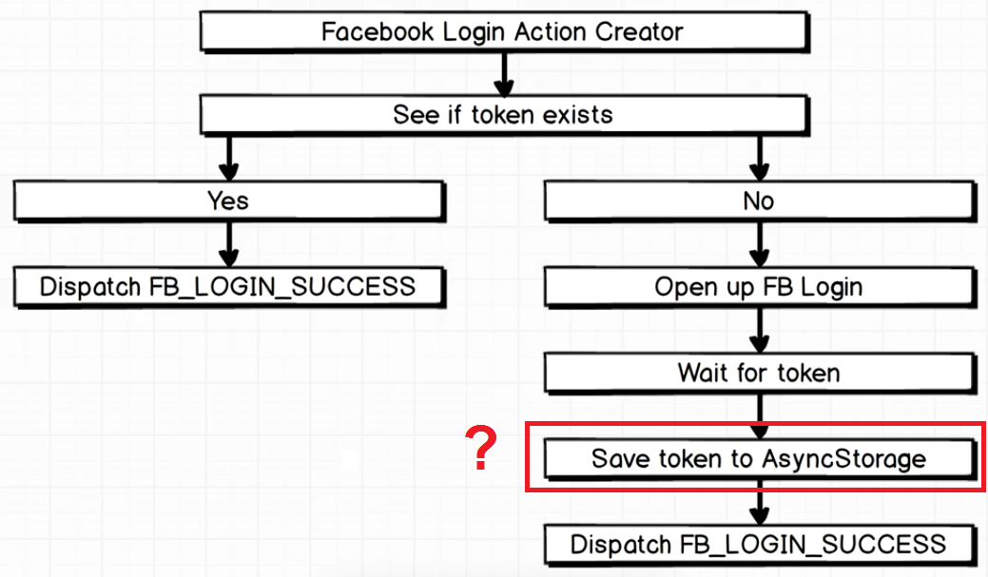
Authentication Flow

Slide 4
Introduction
In the flow diagram, we said that when the user successfully logged in and getting a token, we save it to the Async Storage
But what is Async Storage?

Slide 5
Async Storage
Async Storage is a function or an object or a service that’s a part of React Native that allows us to store small snippets of data directly the user’s phone
It allows us to persist information by writing some code anywhere inside our application

Slide 6
Async Storage
When the user use our app and finish what they’re doing and then close the app or turn off the phone, all of the information inside our Redux Store will be dumped
By default, the Redux Store is sitting in the temporary storage/memory
By default, there is no persistence inside our Redux Store

Slide 7
Async Storage
So to see if the token exists, we’re going to check if we have previously saved a token to the Async Storage
For the first time user use our app, there won’t be any data (token) inside our Async Storage
But after the user logs in at least one time, we’ll save the token there and anytime the user open the app, they won’t have to do a log in again because there’s a token sitting inside our Async Storage

Slide 8
Async Storage
Async Storage in practice works almost identically to Local Storage inside the browser
It’s a simple key-value store

Slide 9
Async Storage
To use Async Storage, we simply use :
AsyncStorage.setItem(‘some_key’, some_value);
AsyncStorage.getItem(‘some_key’);

Slide 10
Async Storage
There’s a little different between Async Storage and the Local Storage
As the name imply, the Async Storage is an Async method
That means that it will takes some amount of time to read or write a value to device

