Slide 1
Applying The Swipe Component
Mobile Developer Fast Track

Slide 2
Introduction
In the last section we brought the Swipe component and hooked it up with the list of job
There’ll be a red error message inside the simulator/device
It’s because we don’t provide some required props to the Swipe component

Slide 3
Introduction
In this section we’re going to work on resolving that by defining the required props
That is the renderCard() and renderNoMoreCard() functions

Slide 4
Introduction
The purpose of renderCard props is to tell the Swipe component exactly how it should style any given data that we provided

Slide 5
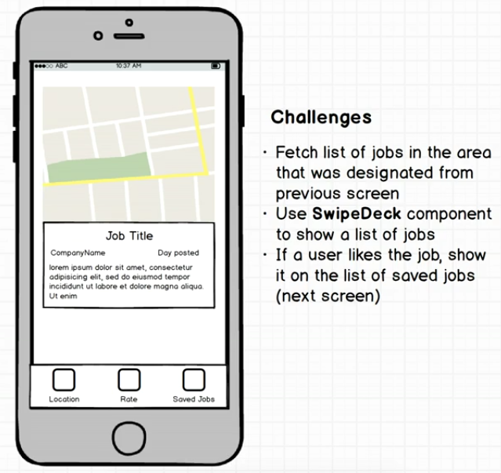
Mockup

Slide 6
Mockup
All the different properties that we’re going to make use inside of the Swipe are easily available on the job object we’re fetching from the Indeed Jobs API

Slide 7
Indeed Jobs API Result

Slide 8
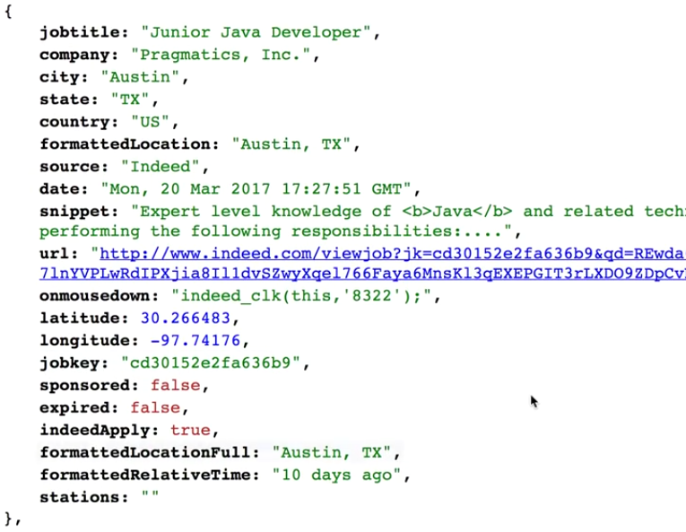

Slide 9
Snippet
Whatever query we made for the job search (in this case the query is “Java”), the query term will be placed inside a bold tag

Slide 10
Snippet
We don’t want to show the bold tag on React Native because they’re totally meaningless
We want to make sure to filter out those bold tag

Slide 11

LatLong
We can use latitude and longitude to pull up a new map view and show it on each individual card

Slide 12
Big Gotcha
In the Swipe component (in the renderCard() function), we made an assumption that every element in the array of source data would have an ID property associated

Slide 13
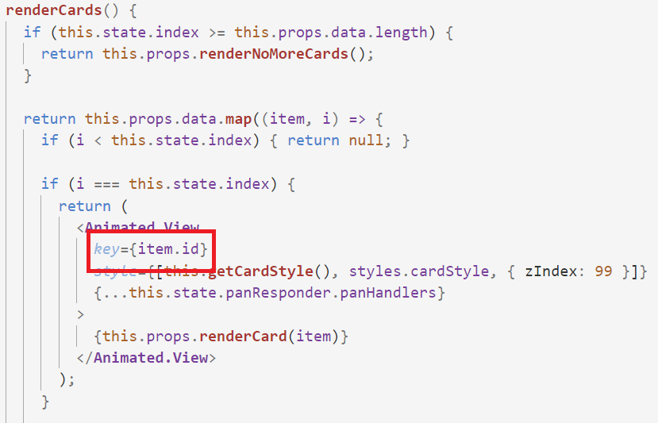
Big Gotcha

Slide 14
Big Gotcha
But in this case, we don’t have an “id” property inside the job data that comes from the Indeed Jobs API
We can get away with trying to show the list of card without assigning an ID to each item
So we’re going to need to figure out some way of getting some other property off of every job record that is going to be both unique and consistent across renderers

Slide 15
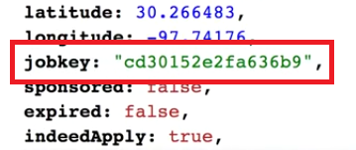
Big Gotcha
Fortunately each job does have something like an ID
It’s called the “jobkey”

Slide 16
Big Gotcha
We’re going to have to do a refactoring to the Swipe component to make sure that it used the “jobkey”, not “id”
We can just change it directly
But it’s better that we change it in some way so that we don’t have to revert it back for the future app

