Slide 1
The Review Screen
Mobile Developer Fast Track

Slide 2
Introduction
As reminder, the Review Screen will be the screen where a user can see the list of jobs that they’ve liked over time

Slide 3
Introduction
Each job that they’ve liked should appear as a card
That card will shows a map of the job location, the jobs title, and a button to apply the job
The Apply button should take the user to a website where the user can apply for it

Slide 4
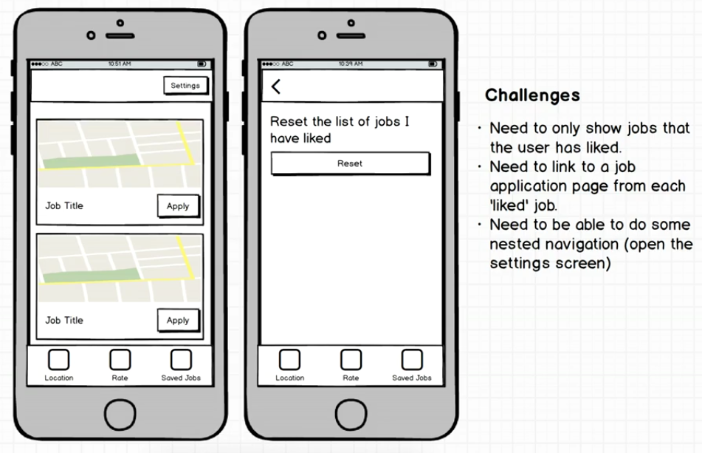
Mockup

