Slide 1
The Welcome Screen
Mobile Developer Fast Track

Slide 2
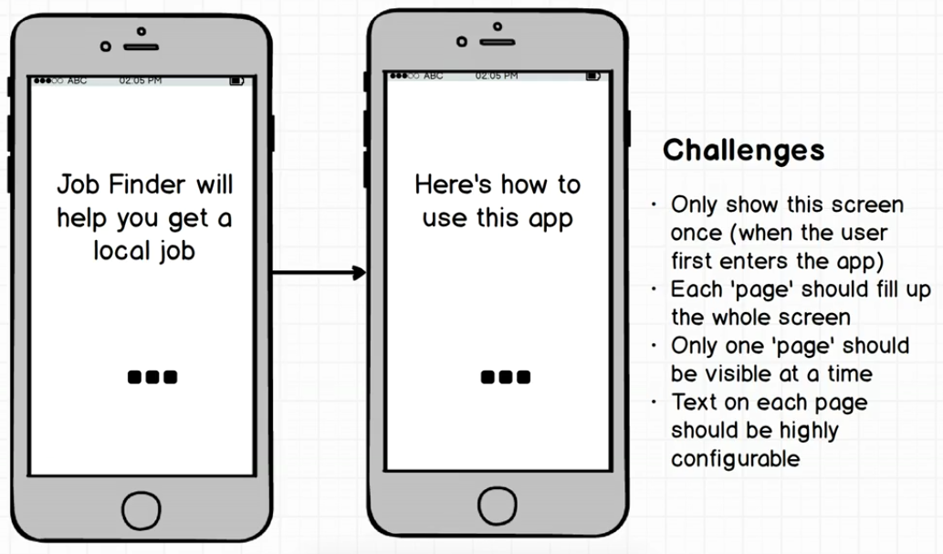
Mockup

Slide 3
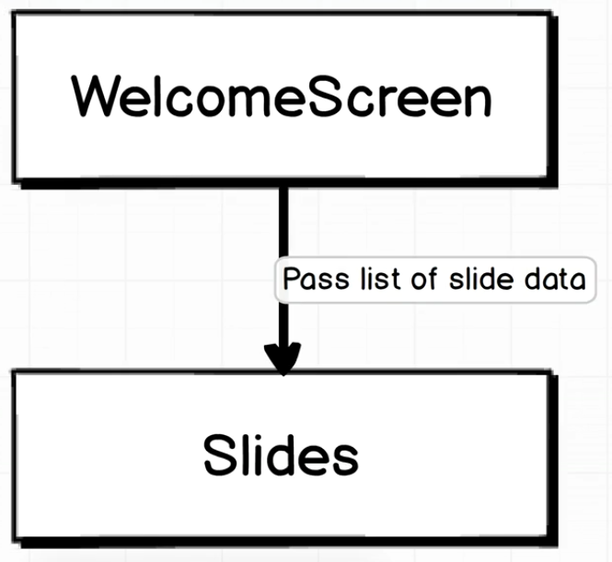
Architecture

Slide 4
Architecture
In the Welcome Screen component, we’ll pass a list of data to a new component called “Slides”
Each data will contains a text or something to be shown to the user for the first time
It will be up to the Slides component to decide exactly how to show the data to the user

