Slide 1
Texting From Twilio
Mobile Developer Fast Track

Slide 2
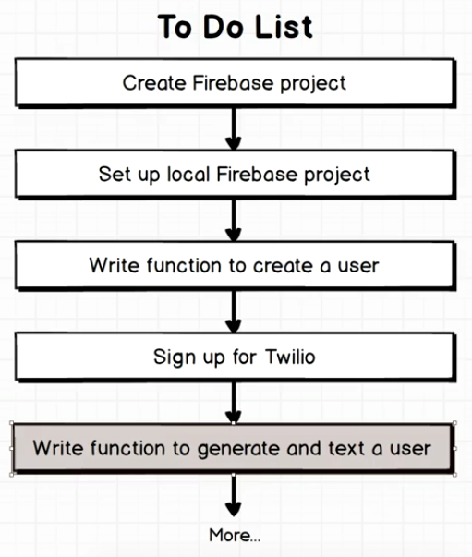
Where We’re At Now

Slide 3
Introduction
To text the user’s phone, we’re going to use Twilio API
In this section, we’re going to walk through the process of signing up for Twilio and getting an account token to use

Slide 4
Signing Up
Open Twilio’s site and sign up there
https://www.twilio.com/

Slide 5
Twilio
You can text message people without associating a credit card to your account
After successfully sign up, login to the Twilio and visit the dashboard

Slide 6
Twilio
The first thing that we have to do is create a new phone number that will be used to text users
So whenever you use Twilio to text people, things just don’t automatically done for you
You have to first sign up for a number that will be used as the recipient address

Slide 7
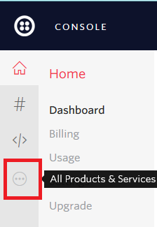
Create a Phone Number

Slide 8
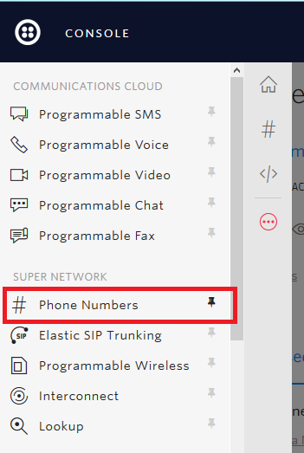
Create a Phone Number

Slide 9
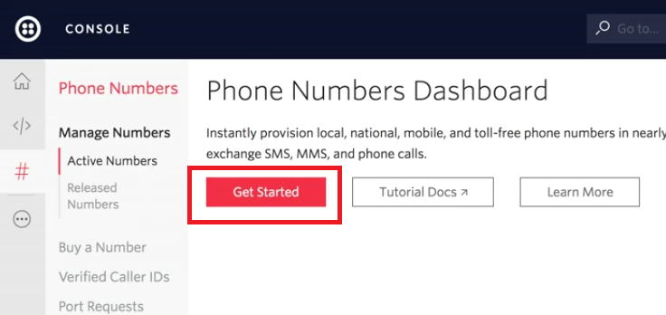
Create a Phone Number

Slide 10
Create a Phone Number
Trial account in Twilio will get access for 1 phone number for free
We won’t pay for the first phone number that we’ll use

Slide 11
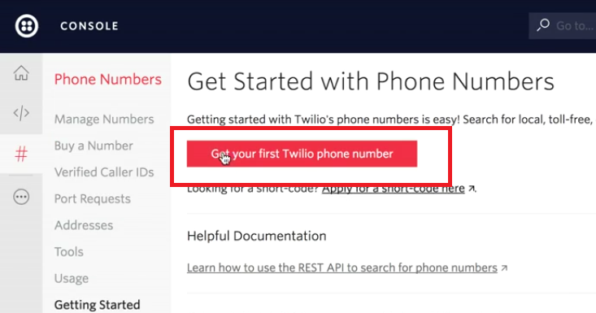
Create a Phone Number

Slide 12
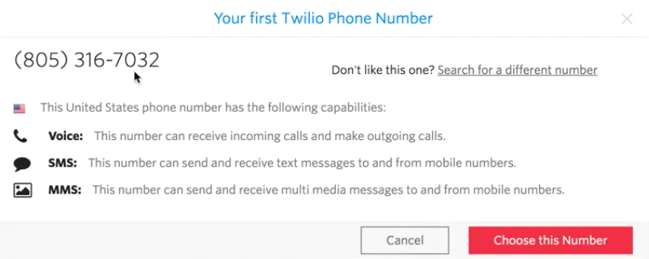
Create a Phone Number

Slide 13
Create a Phone Number
By default, we’ll get an Indonesian phone number
But because of the Twilio’s limitation, the Indonesian phone number that we’re assigned can’t send and receive an SMS
This will be troublesome for us as we want to send text to the user
So don’t pick the Indonesian phone number
Instead we can choose the US phone number

Slide 14
Create a Phone Number
Remember the phone number and click “Done”

Slide 15
Testing
After we successfully create a new phone number, it’s better for us to test that to send a text to our own phone number
We can test this by using Twilio’s own API Explorer

Slide 16
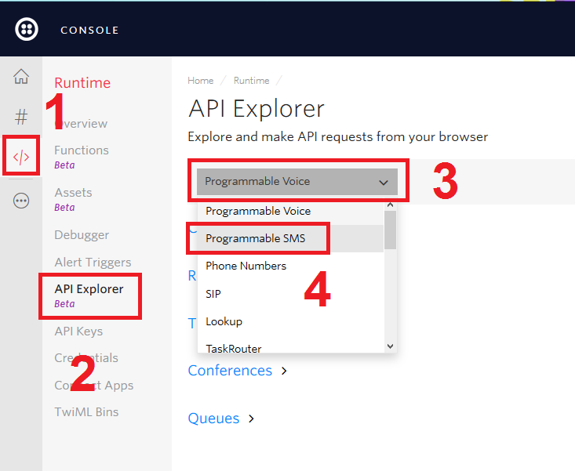
Testing

Slide 17
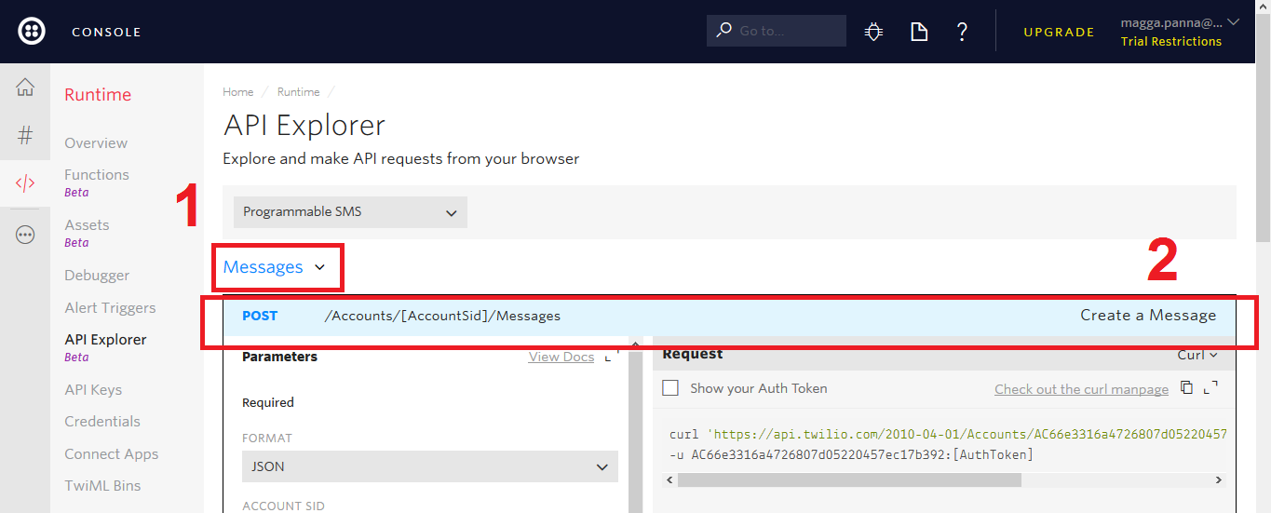
Testing

Slide 18
Testing
Select “From” section to the US’ phone number that you create before
Fill the “To” section with your own phone number (for Indonesian number, add +62 in front of the phone number)
Fill the “Body” with the test message that you want to send
Click “Make Request”

