Slide 1
App Overview
Mobile Developer Fast Track

Slide 2
Introduction
In this section we’re going to make the biggest app so far
There is a lot of preamble to do about this app
It’s very large in scope, many different features, several different screens, a lot of different stuff going on

Slide 3
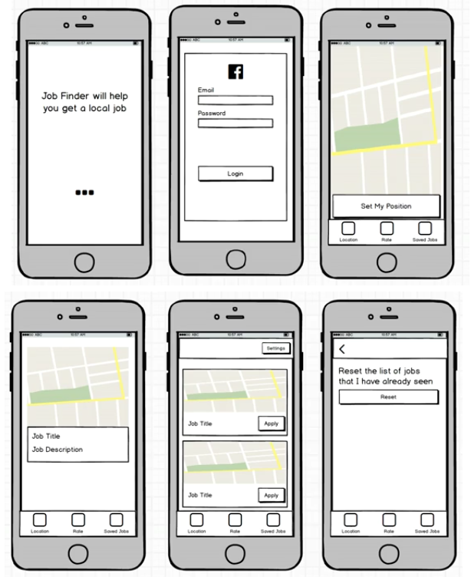
Mockup

Slide 4
The App
The overall goal of the app that we’re going to make is a job finding app
The user can look for a job, any kind of job

Slide 5
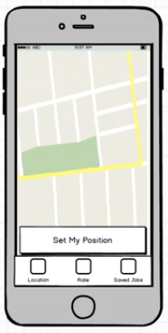
The App
The ide is that user will pan around on some map inside the app
They click on the “Set My Position” button and we’ll use some API which will return a list of eligible jobs around that position

Slide 6
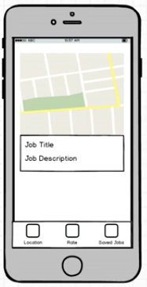
The App
In the review screen, there’s a decks of job
User can swipe right to show interest, or left to discard that job (like a Tinder dating app)
If the user swipes right, it’ll save the job so it can be seen on the “Saved Jobs” tab

Slide 7
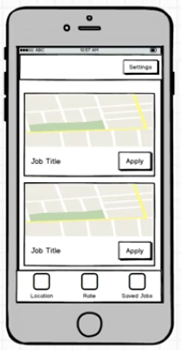
The App
The user can review the list of jobs that they like
They can click on “Apply” button to go to a screen to automatically applied to that particular job
That screen will be a web interface that is a part of the API that we’re going to use (we won’t tackle that job applying process)

Slide 8
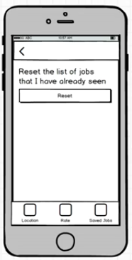
Misc
User can reset their saved list of jobs via the Setting menu

Slide 9
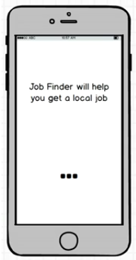
Misc
When user first installs the app, we want to give them a little tutorial
It will be an introduction to the app and tell them what the app does and how it works
The user will slide through a couple of different screens that have some text that contains a walkthrough

Slide 10
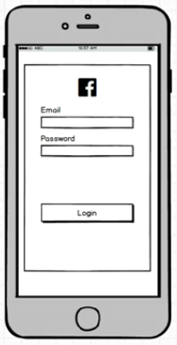
Misc
To logged a user in, we’re going to use Facebook Oauth
We won’t use it to post something to user’s Facebook account or anything

