Slide 1
Screen Walkthrough
Mobile Developer Fast Track

Slide 2
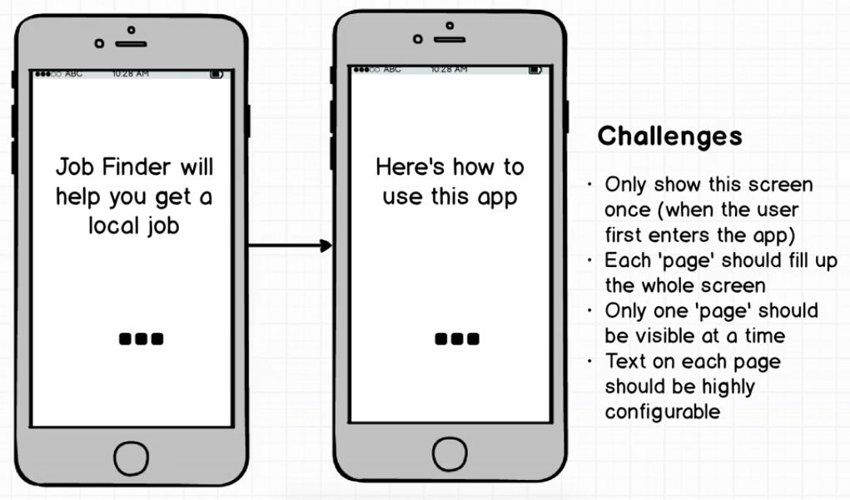
The Challenges

Slide 3
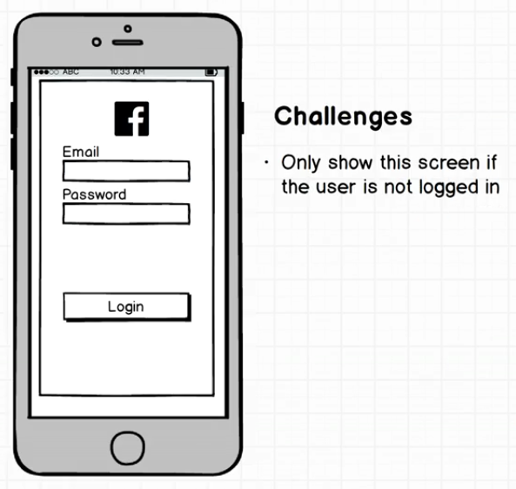
The Challenges

Slide 4
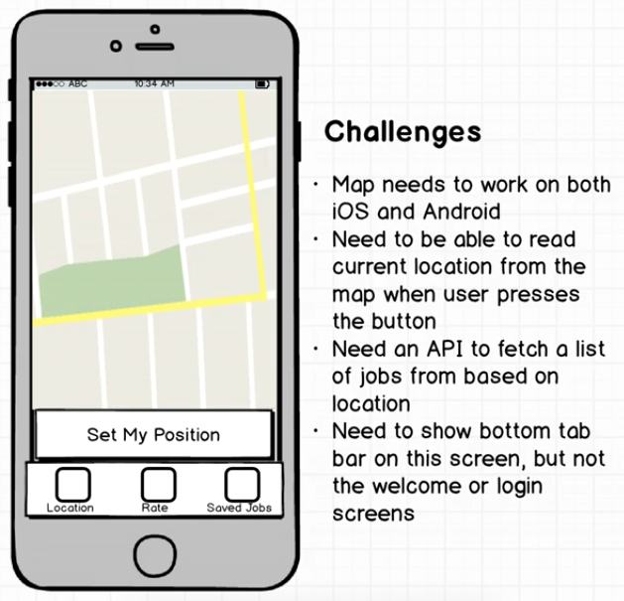
The Challenges

Slide 5
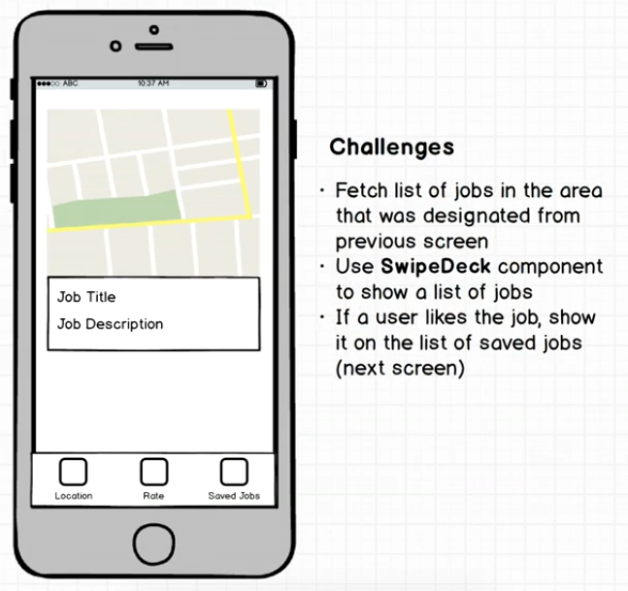
The Challenges

Slide 6
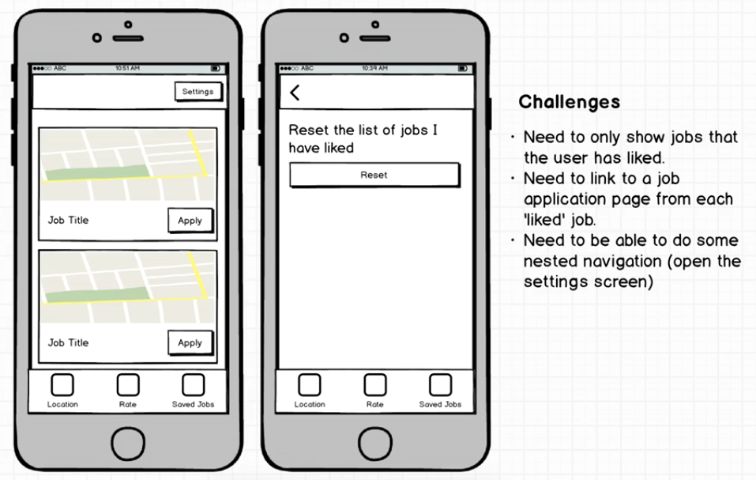
The Challenges

Slide 7
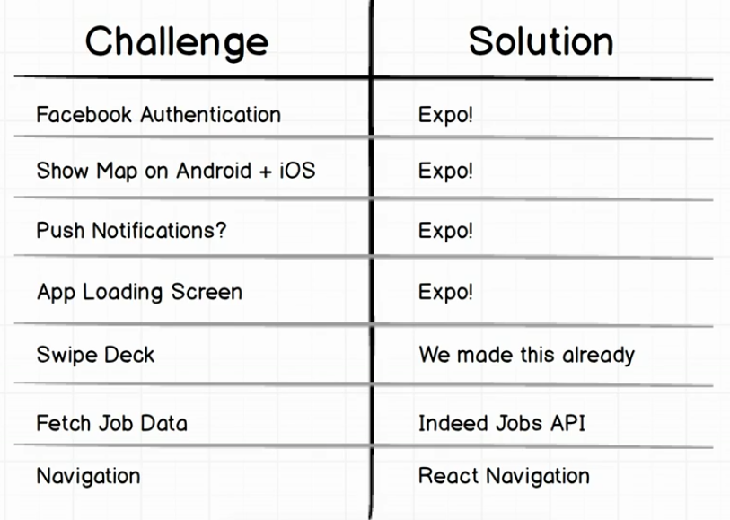
The Solution

