Slide 1
Screen VS Component
Mobile Developer Fast Track

Slide 2
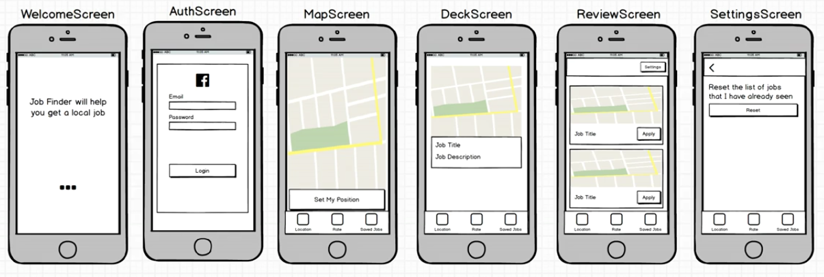
The Screen

Slide 3
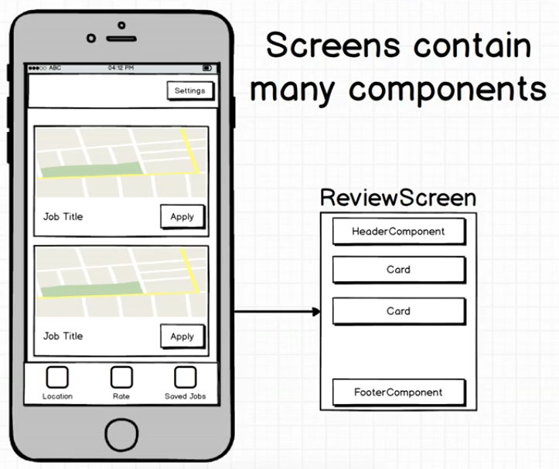
Screen VS Component

Slide 4
Screen VS Component
Inside our app we’ll have many different screens
Each screen will contains many different reusable components

Slide 5
Screen VS Component
A screen is still a React component
So we still have to make a screen component (ex. Welcome Screen component, Auth Screen component, etc)
That screen component will be used one time inside the app
There’ll be a folder that is full of different screens and folder that is full of different components inside our app

Slide 6
Screen VS Component
So one real distinction between screen and component is one set of component is intended to be reusable, and the other one is otherwise

