Slide 1
React Native Navigation Options
Mobile Developer Fast Track

Slide 2
Introduction
Navigation with React Native is the biggest quagmire around when it comes to javascript engineering
With React Native, we have so many navigation options

Slide 3
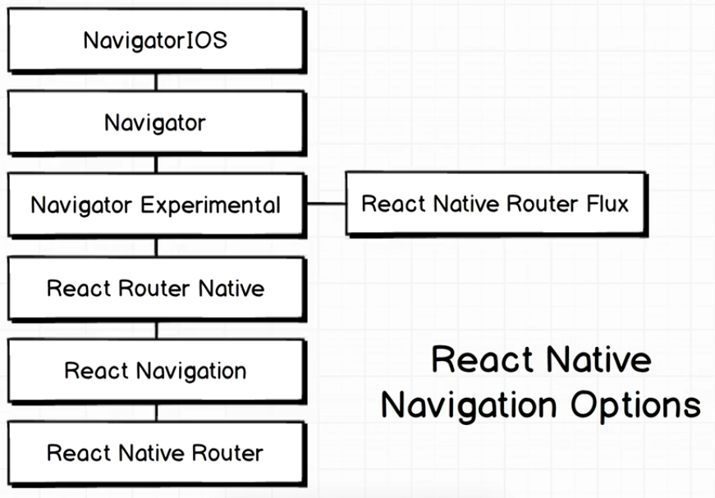
Navigation Options

Slide 4
Navigation Options
That’s not even a complete list!

Slide 5
Navigation Options
In this app, we’ll use React Navigation
It was made as a joint project of Facebook, Expo, and React Native Community
It’s a really solid navigation option for React Native right now

Slide 6
React Navigation
Navigating between different screens is really straightforward
It includes a lot of default components with a lot of options that are going to cover different use cases for navigation
The API is arguably very stable

