Slide 1
React Navigation In Practice
Mobile Developer Fast Track

Slide 2
Introduction
To view the React Navigation’s documentation, visit
https://reactnavigation.org/

Slide 3
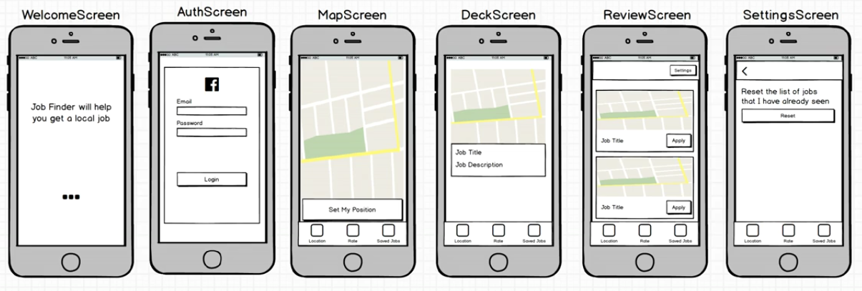
App Navigation

Slide 4
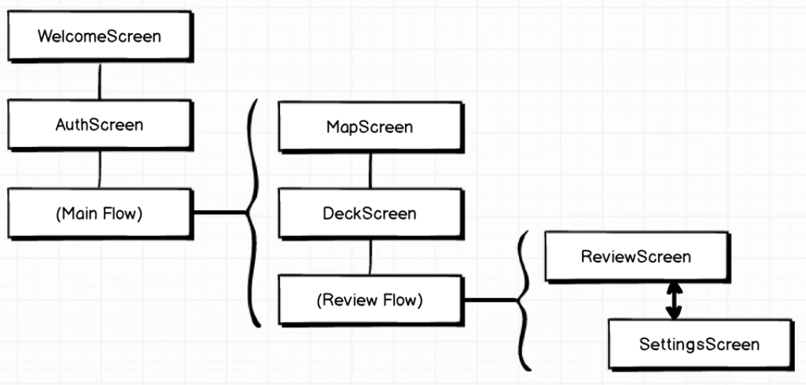
App Navigation

Slide 5
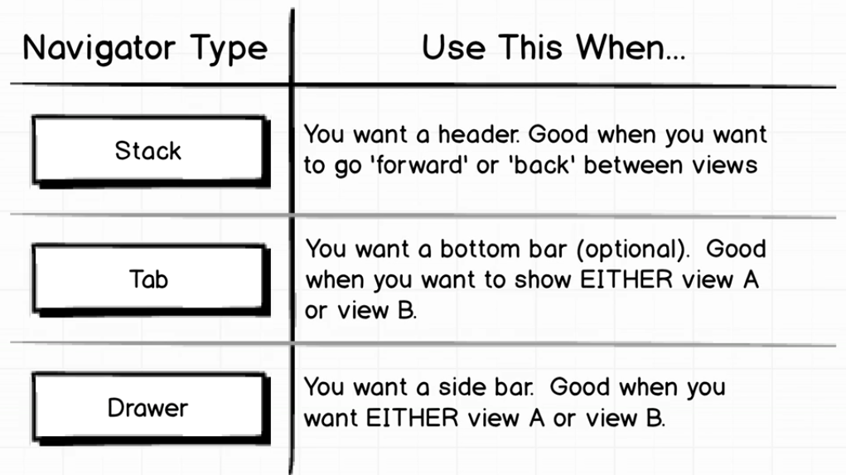
Navigation Type

Slide 6
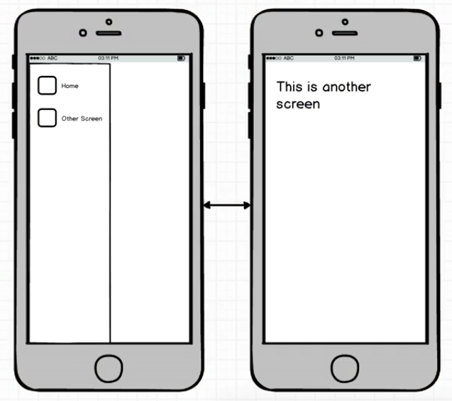
Drawer Navigator

Slide 7
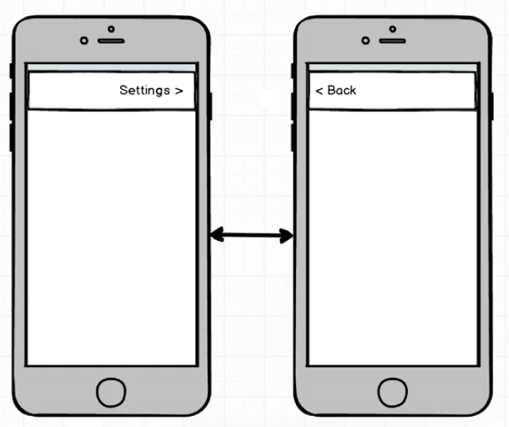
Stack Navigator

Slide 8
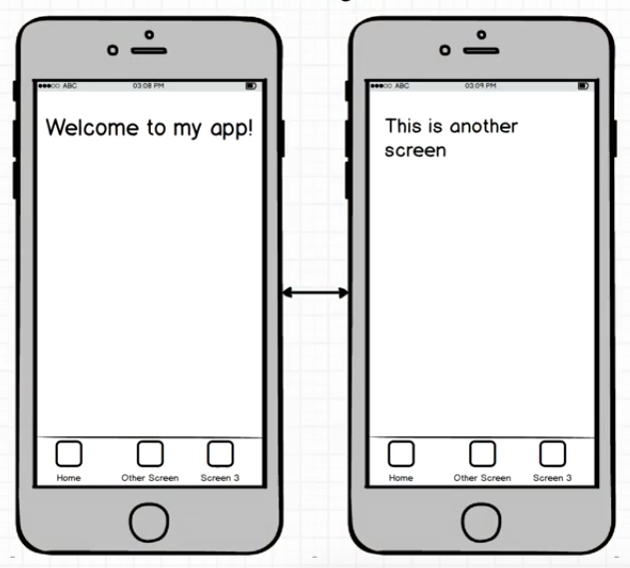
Tab Navigator

Slide 9
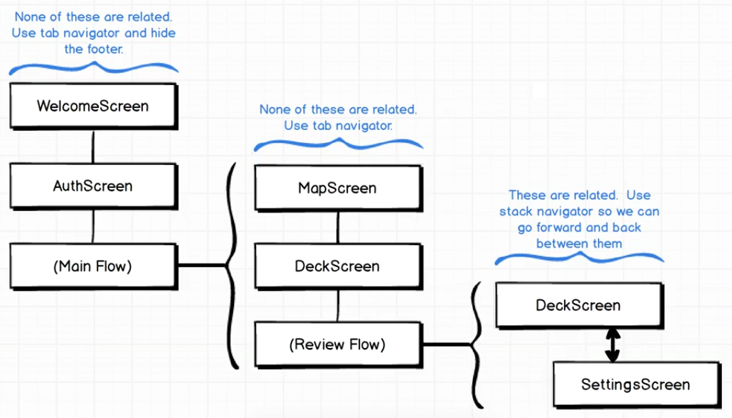
Applying Navigator

