Slide 1
Class VS Instance Properties
Mobile Developer Fast Track

Slide 2
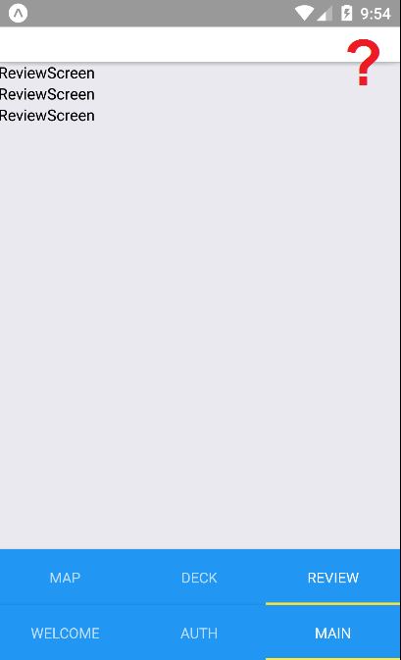
Introduction
In the previous section we successfully nested the Stack Navigator inside a Tab Navigator
But we still can’t see any ability to navigate over from Review Screen to the Setting Screen

Slide 3
Introduction
We need to add some configuration to the Stack Navigator to give us a button
The button will appear in the Review Screen’s header and allow us to navigate over to the Setting Screen

Slide 4
Introduction
To do that we have to learn some ES6 syntax first, that’s called Class properties

Slide 5
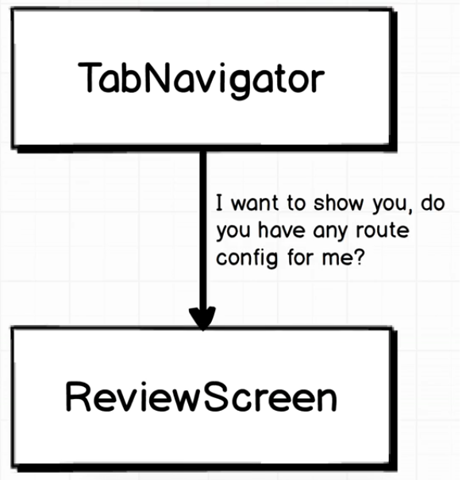
Navigator Relation

Slide 6
Navigator Relation
Whenever the Tab Navigator is about to show a component, it asks that component if it has any routes specific configuration
That configuration will tell the Navigator to customize something (ex. the header’s text, icon, etc)

Slide 7
Navigator Relation
The question is, how do we specify route specific configuration inside of a component
To do so, we use Class Properties

Slide 8
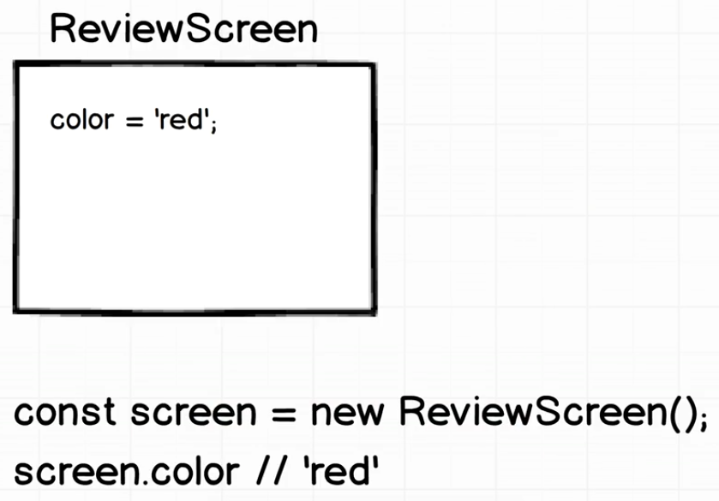
Instance Property

Slide 9
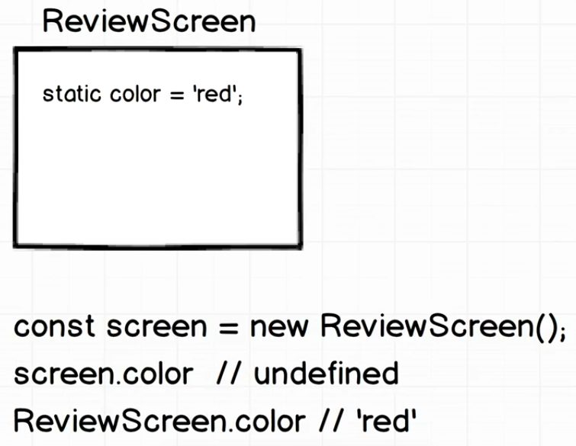
Class Property

Slide 10
Class Property
This is where we’re going to define properties for the Stack Navigator to get some routes specific configuration
Whenever the Tab Navigator is about to render a component, it will look at Review Screen Class, and look for a very specific property on that class
If the Tab Navigator sees a property defined there, it will use that to customized some of the behavior of the route

Slide 11
Code
Time to put some code!

