Slide 1
Interacting With The MapView
Mobile Developer Fast Track

Slide 2
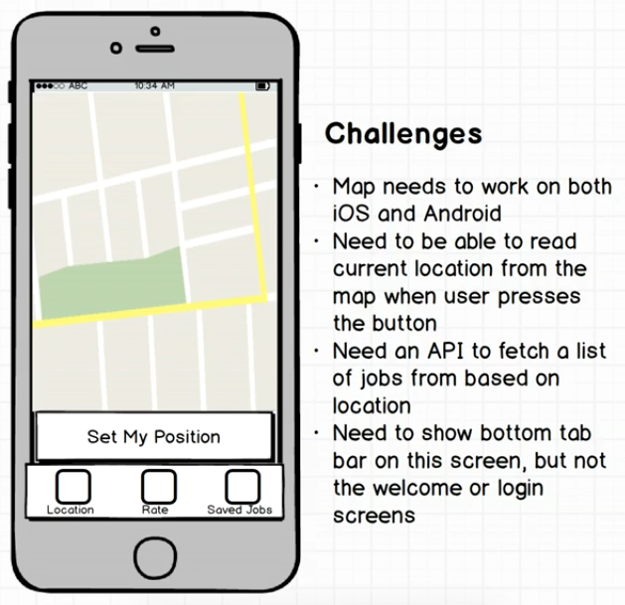
Mockup

Slide 3
Introduction
For more information about Expo’s MapView, visit
https://docs.expo.io/versions/latest/sdk/map-view.html

Slide 4
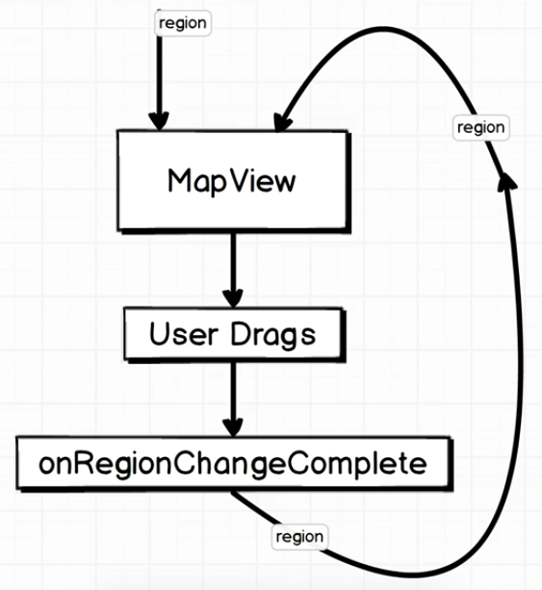
Interacting With The MapView

Slide 5
Region
To set the initial location (center of the map and how far the zoom level) when we first render the MapView, we can pass in something called Region props
Region is an object that describes a longitude, latitude, longitude delta, and latitude delta
Those 4 properties are used to position the map on the screen

Slide 6
Region
The latitude and longitude are used to position it in sort of the X and Y direction
The latitude delta and longitude delta are used to control the zoom level of the map

Slide 7
Region
Every single time the user drags the map around, a callback will be called, that is onRegionChangeComplete
It will give us the updated region location on the map

