Slide 1
The Indeed Jobs API
Mobile Developer Fast Track

Slide 2
Introduction
To get the list of jobs around one point of location, we use the Indeed Jobs’ API

Slide 3
Introduction
To register to the Indeed Job’s API, visit
https://www.indeed.com/publisher

Slide 4
Indeed
Indeed Job’s API is the API that we’re going to use to get a list of jobs around a certain longitude and latitude
Indeed.com is a very popular job aggregation website
You can find jobs all over the world

Slide 5
Indeed Publisher
The Publisher program is used to get programmatic access to the job’s API
With that, we can search for jobs given a certain term or location or other factors

Slide 6
Indeed API
Check the documentations to get the full list of the API capabilities

Slide 7
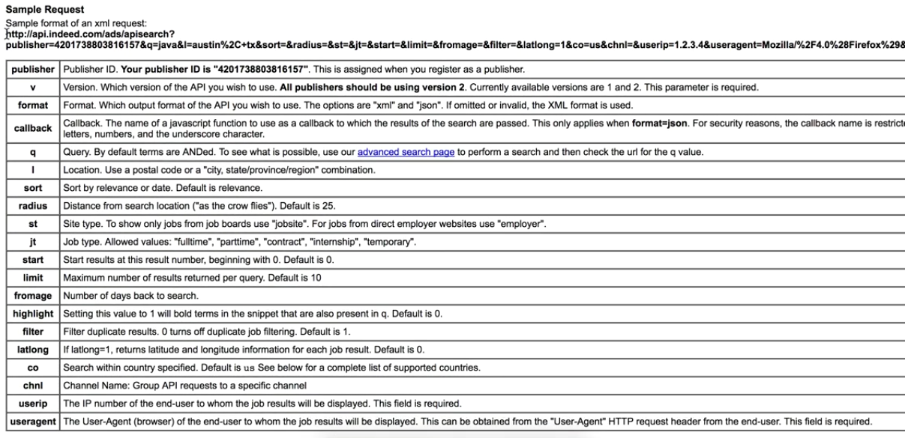

Slide 8
Try It
http://api.indeed.com/ads/apisearch?publisher=4201738803816157&format=json&l=Jakarta&v=2&co=ID

