Slide 1
Review of Common Authentication Flows
Mobile Developer Fast Track

Slide 2
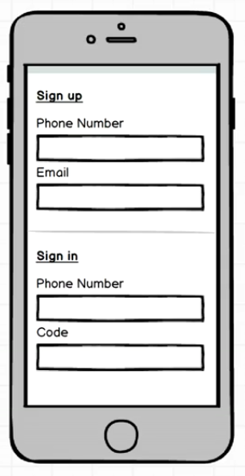
Mockup

Slide 3
Mockup
The application we’re going to build will be a single page
It’s going to have 2 sections to it, Sign Up and Sign In
It’s basically an authentication app

Slide 4
Mockup
This will be a complex app and has a lot of work to do because of the authentication process that is going to be put together

Slide 5
Mockup
We won’t collecting any Email and Password from the user
We’re collecting a phone number and email
And when the user attempts to sign in, we’re collecting a phone number and some sort of code, as opposed to a password

Slide 6
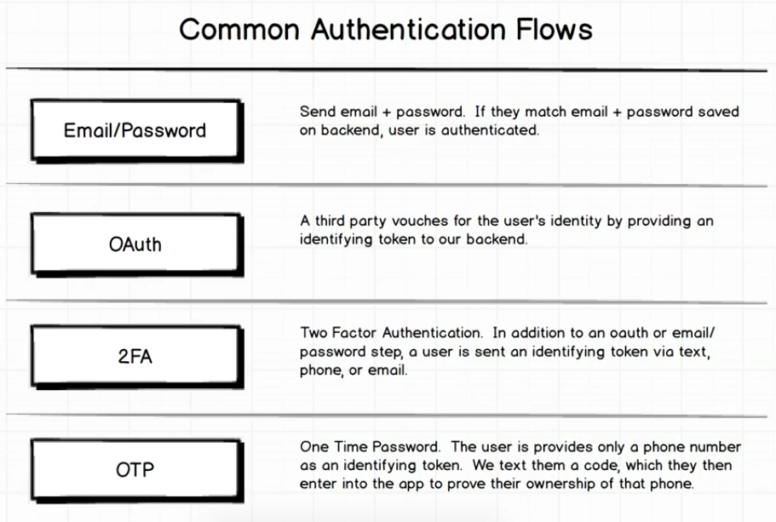
Authentication Flow

Slide 7
Mockup
The app may sound simple
There’s not going to be a tremendous amount of React Native stuff to do
We’re going to be focusing on a lot of companion technologies that we’re going to see with mobile apps
If you start to build any serious mobile app, you’re going to start to run into these technologies

