Slide 1
The Details of One Time Password
Mobile Developer Fast Track

Slide 2
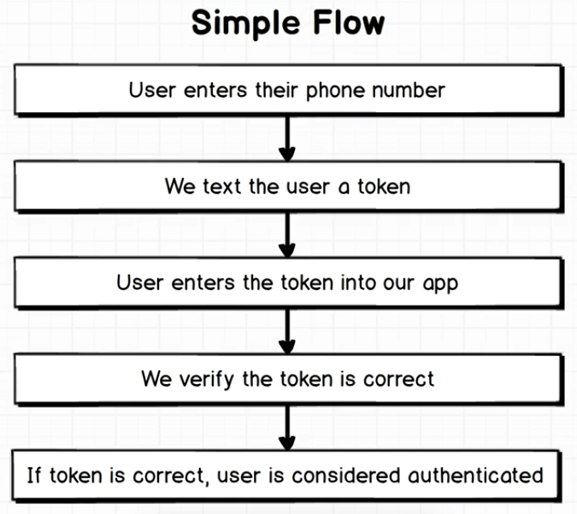
The Flow

Slide 3
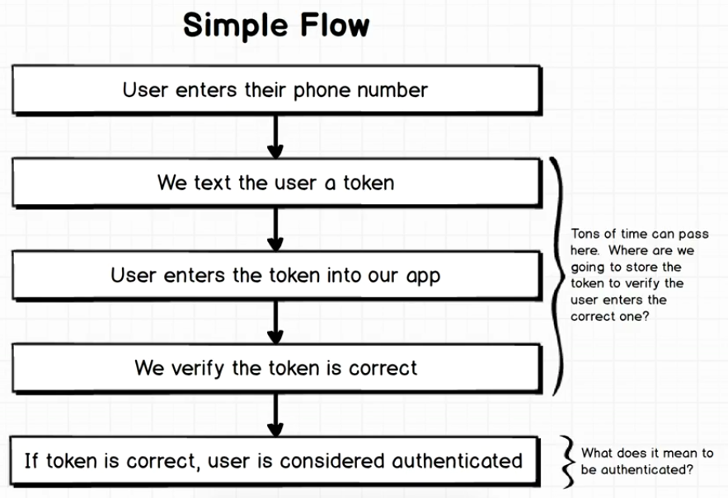
The Flow

Slide 4
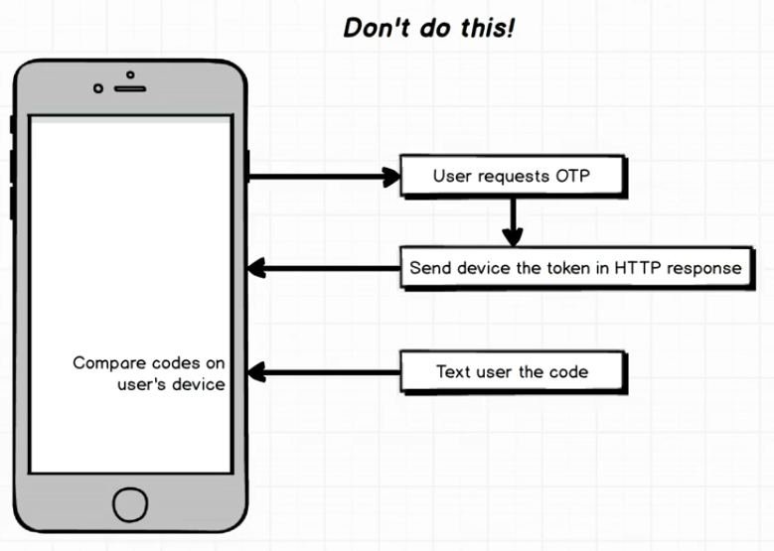
The Flow

Slide 5
The Flow
That flow is not recommended
We don’t want to store the code in the user’s device and compare it there
We don’t want to send the code that we expect the user to enter via some type of HTTP Request and stored the on the mobile device

Slide 6
The Flow
The reason for that is that the user can somehow hack into the response
They can get their eyes on the response that come back and look at the code that is provided
We’re never going to do any type of comparison of the code that we sent to the user on the mobile device itself

Slide 7
The Flow
We need to have some external service (server) that is going to do the comparison

Slide 8
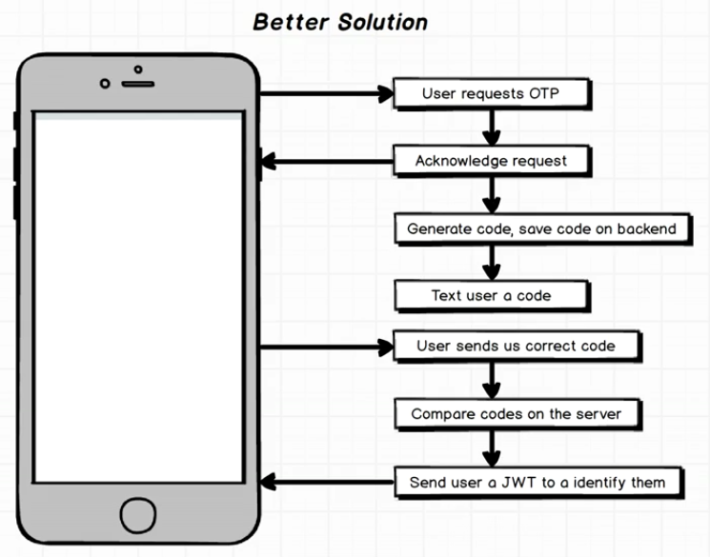
Better Solution

