Slide 1
Tech Stack With Google Cloud Function
Mobile Developer Fast Track

Slide 2
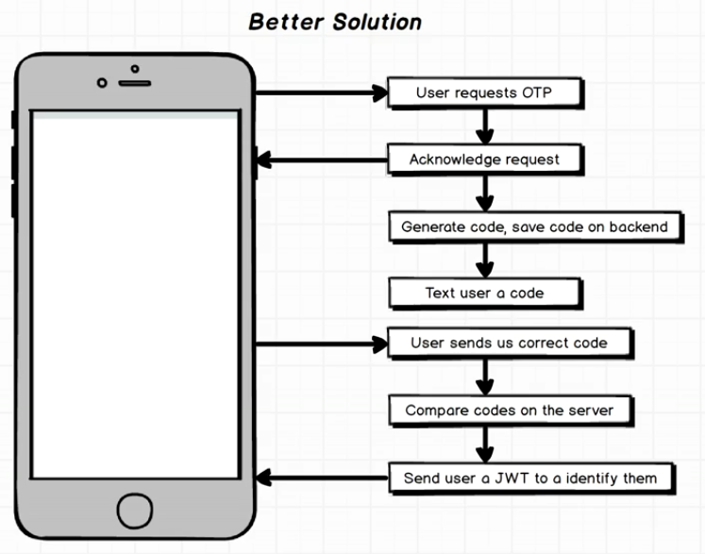
The Flow

Slide 3
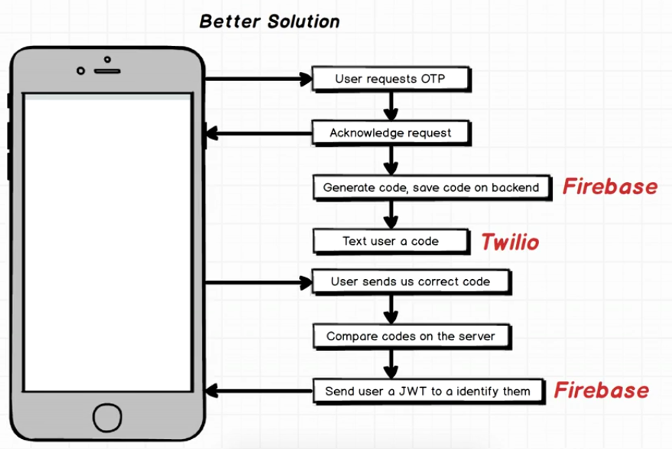
The Technologies

Slide 4
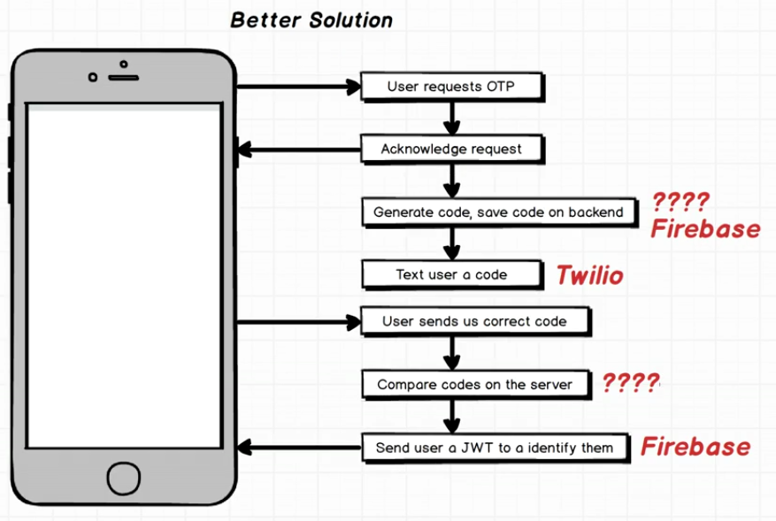
The Technologies

Slide 5
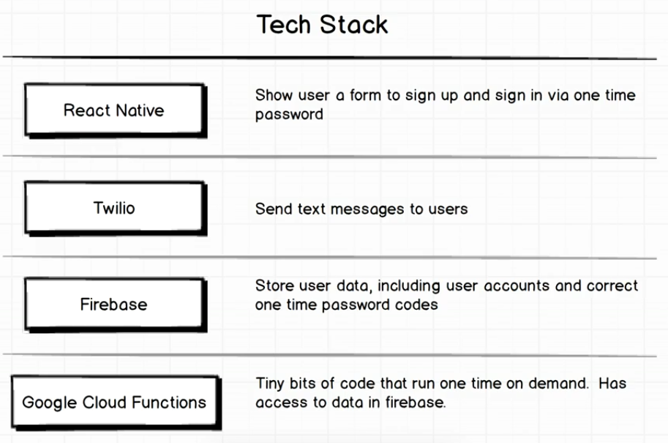
Tech Stack

Slide 6
Google Cloud Function
Google Cloud Function is a tiny bits of code, not a full featured backend server
It’s a tiny code that we can run on Google server

Slide 7
Google Cloud Function
Google Cloud Function have a very tight interoperability and integration into Firebase Datastore
A very common use case of Google Cloud Function is to add some logic or processing to the data that is sitting inside the Firebase

Slide 8
Google Cloud Function
Google Cloud Function is a new paradigm in cloud computing
It’s very much unlike any API service that we’ve used before

Slide 9
Summary
This section will be focusing much on Google Cloud Function and figuring out how they work

