Slide 1
Traditional Server VS Google Cloud Function
Mobile Developer Fast Track

Slide 2
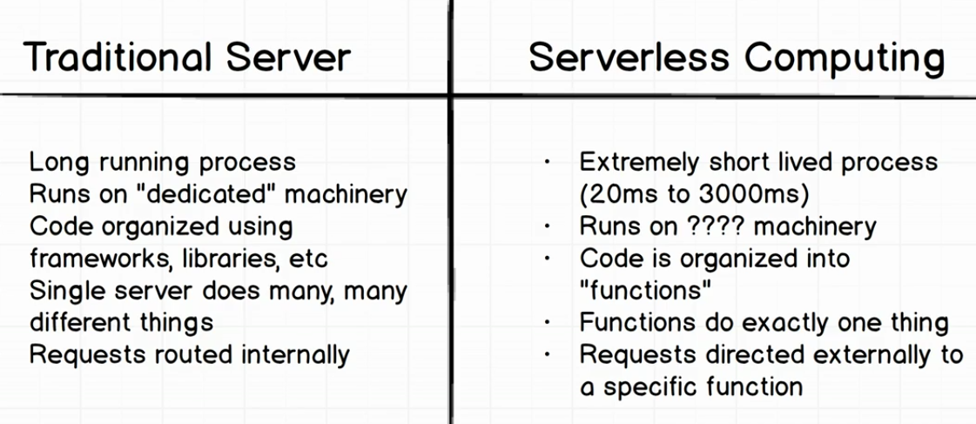
The Difference

Slide 3
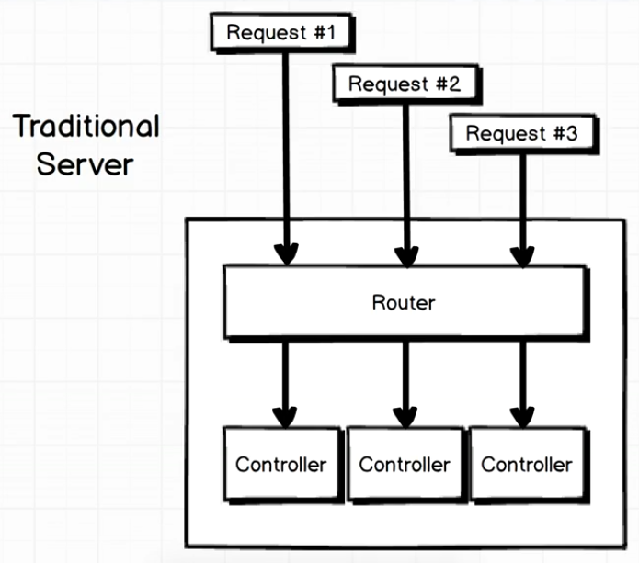
Traditional Server

Slide 4
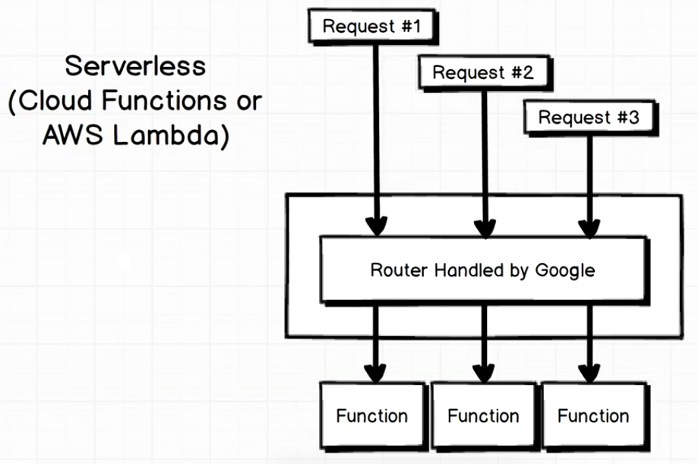
Serverless

