Slide 1
The Layout of Google Cloud Function
Mobile Developer Fast Track

Slide 2
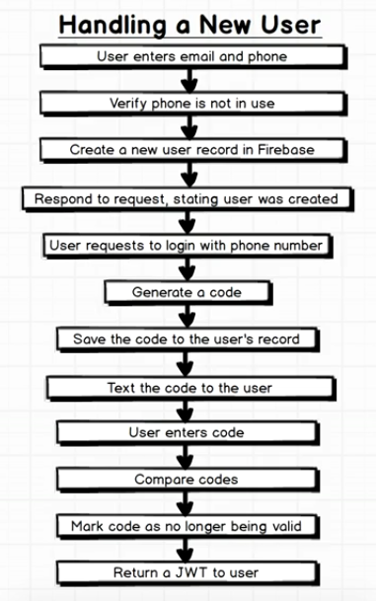
Handling The User

Slide 3
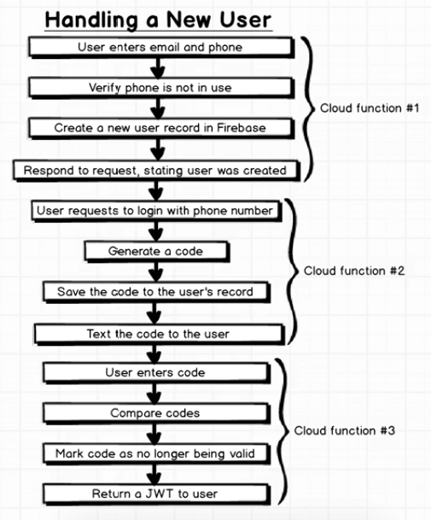
Handling The User

