Slide 1
Firebase Project Setup
Mobile Developer Fast Track

Slide 2
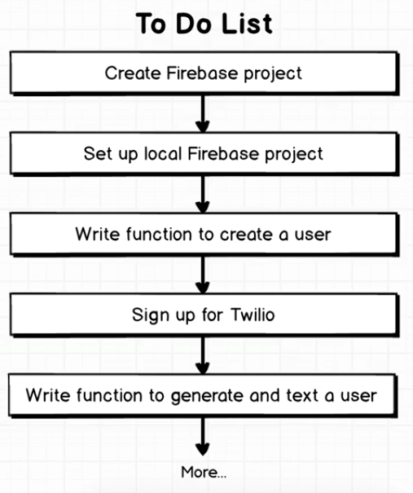
What We Do Now

Slide 3
Create Firebase Project
To create a Firebase project, visit the Firebase console
https://console.firebase.google.com

Slide 4
Firebase Tool
Install the Firebase Command Line Tools from npm
npm install -g firebase-tools
This tool is used to generate a new Firebase local project
The local project is what we used to add a new Google Cloud Function
To check the installation, run in the terminal
firebase --version

Slide 5
Firebase Tool
After successfully installed the Firebase tools, we have to login first with the command
firebase login
Once you’ve been signed in, you can generate a new local project by running
firebase init

Slide 6
Firebase Init
After init, you’ll be shown some configuration to be made
First, select which Firebase CLI features do you want to setup
Select the Functions option by hitting “space” button on the keyboard
After the Functions selected, press enter

Slide 7
Firebase Init
After that, select the Firebase project that you’ve created in the previous step
This will associate your local project with that Firebase project

Slide 8
Firebase Init
Next, choose yes to install the npm dependencies
That’s it!

