Slide 1
Transitioning To React Native
Mobile Developer Fast Track

Slide 2
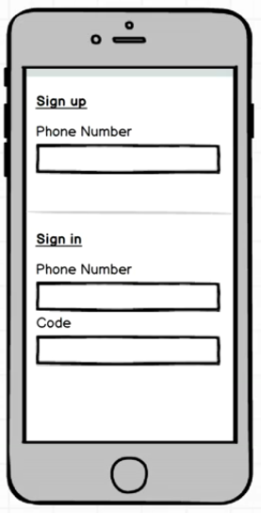
Mockup

