Slide 1
Push Notification And Data Persistence
Mobile Developer Fast Track

Slide 2
Introduction
Our app is look pretty good right now
But there’s a couple of features that we can add on
It’ll make the app better and more compelling

Slide 3
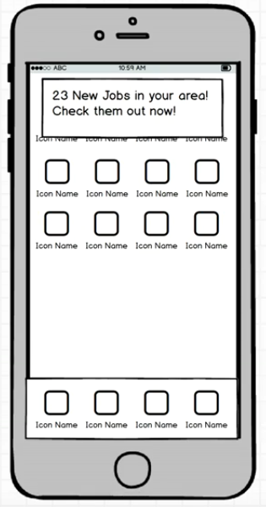
Push Notification

Slide 4
Push Notification
There’s so many thing we can do with Push Notification
The main purpose of Push Notification is to be a tool to drive engagement to the user

Slide 5
Push Notification
Push Notification usually looks like a popup that appear on the mobile device
It will contains a customize message
The popup itself will be displayed even if the user is not currently using our app
When the user tap that popup message, they’ll automatically redirected into our app

Slide 6
Push Notification
We’ll figure out how to set up push notification for our app

Slide 7
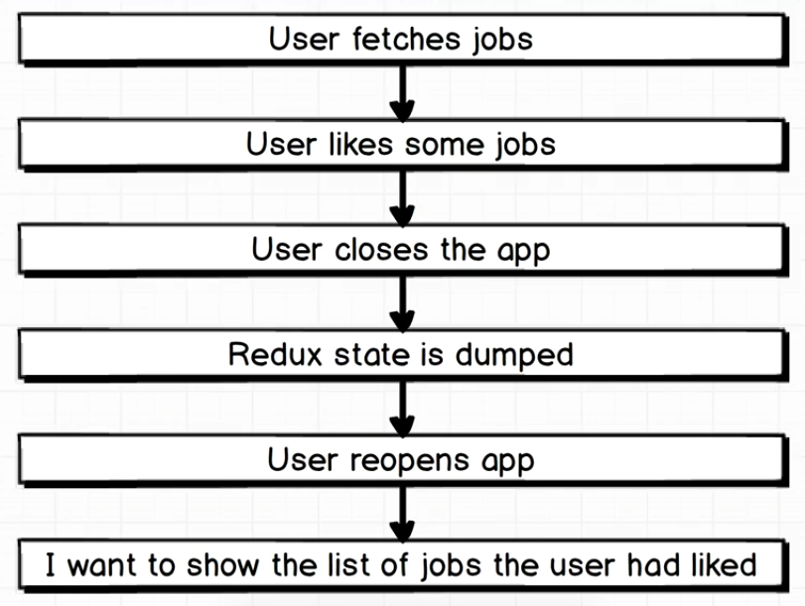
Another Little Problem

Slide 8
Data Persistence
If the user liked a job and then close the app, the liked jobs will be dumped
We want it to persist the user’s liked jobs data even when the user close the app

