Slide 1
Persisting Application State
Mobile Developer Fast Track

Slide 2
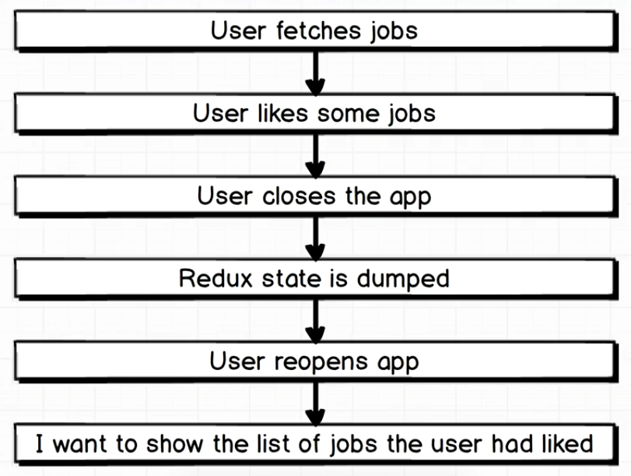
Introduction

Slide 3
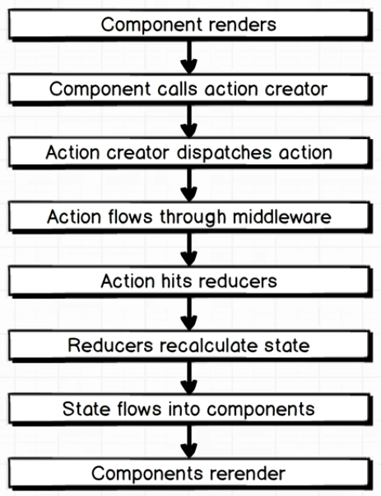
How Redux Works In General

Slide 4
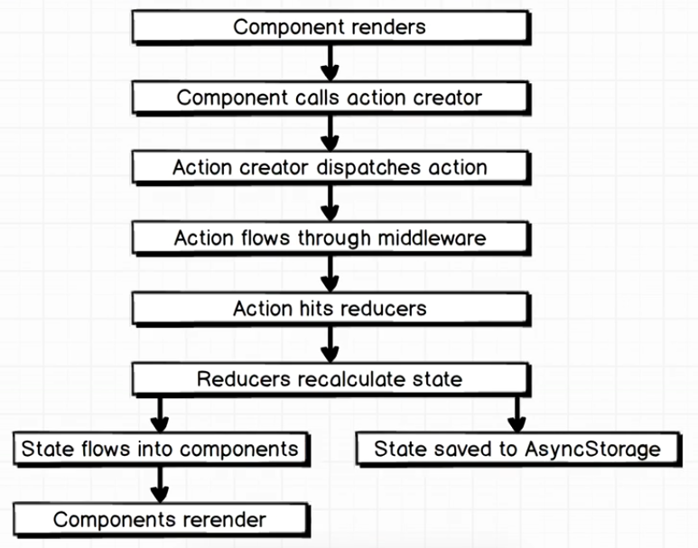
Proposed Flow

Slide 5
Proposed Flow
So the proposed flow here is that when we modify the reducer, we’ll automatically saved that state into the AsyncStorage
Remember that the data saved in AsyncStorage won’t be wiped out even when the app is closed

Slide 6
Proposed Flow
We’ll talk about the library that we’re going to use for that automatic stuff
We’ll walk through the implementation of that library
We’ll talk about how our state is going to be consumed out of AsyncStorage

Slide 7
Introducing Redux-Persist
Visit here for documentation
https://github.com/rt2zz/redux-persist

Slide 8
Introducing Redux-Persist
We’ll just talk about the basic usage of Redux Persist for now
We’ll talk more about the concept behind the Redux Persist
And the most important is that there’s a BIG problem when using the Redux Persist that we may run into

Slide 9
Introducing Redux-Persist
Install the redux-persist by running command
npm install --save redux-persist@4.6.0
Note that we use version 4.6.0 as the latest version (v5) is not stable yet and there’s many groundbreaking change from v4

