Slide 1
How Redux Persist Works
Mobile Developer Fast Track

Slide 2
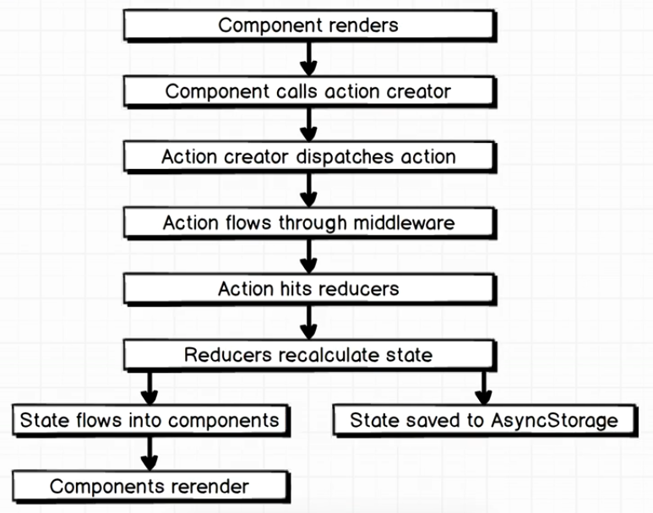
Introduction

Slide 3
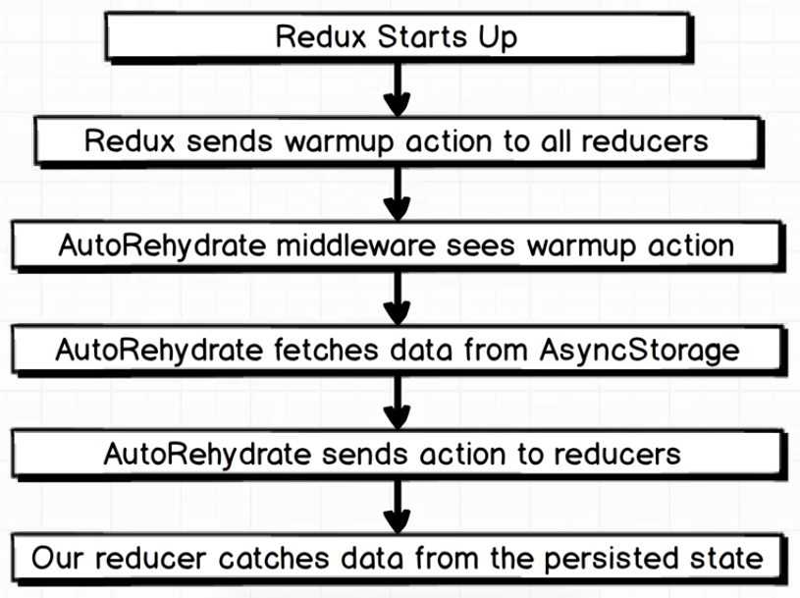
How Redux Persist Works

