Slide 1
Redux Persist - Huge Gotcha
Mobile Developer Fast Track

Slide 2
Introduction
When we use Redux Persist to automatically save and load a state into AsyncStorage, there’s one case when if it happened, our app will be likely to get crashed

Slide 3
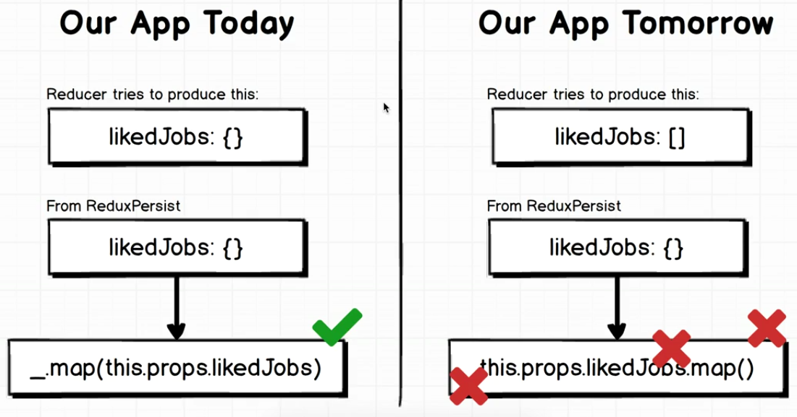
Gotcha

Slide 4
Gotcha
There’s a case when, in some day in the future, maybe we want to change a type of one of our data
For example in the first version of the app, “likedJobs” was saved as an array
And someday we want to change it as an object
Because what we saved on AsyncStorage is an array, and we process it in our app as an object, surely it’ll have some issue in our code
For example we can’t use a “.map()” function in an object

Slide 5
Gotcha
This gotcha only happened if we change the data type of the state that we save in AsyncStorage
If we never change that type, we can safely use the Redux Persist without any worry

Slide 6
Solution
To avoid this gotcha, we can use a “migration” (please visit the documentation for more information) before we update the app
Or we can use the v5 of the library (but there’ll be tremendous amount of code changes from v4 that we use)

