Slide 1
Testing Deployed Functions
Mobile Developer Fast Track

Slide 2
Introduction
In the last section we finished generating our first project and then immediately deployed it with some of the boilerplate code that it contained

Slide 3
Introduction
Remember that we’re working with a local Firebase project
We can configure this local Firebase project and then deploy it to our remote Firebase project
We can update the configuration, settings, and behavior of that remote Firebase project too
In practice, this is how we write all of the different Google Cloud Function

Slide 4
Functions
To see the code that we’ve deployed, open the Firebase Console and see the Functions menu

Slide 5
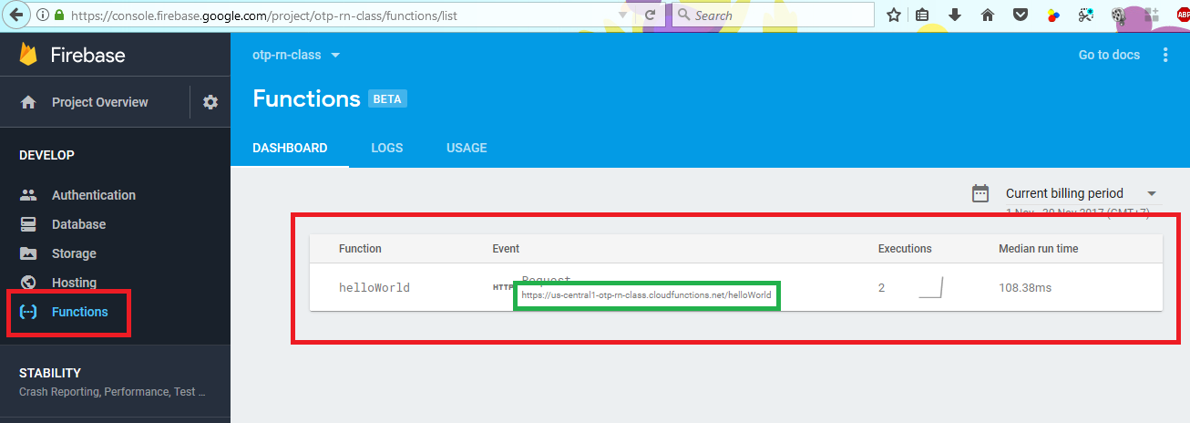
Functions

Slide 6
Functions
Copy the link (in the green box) and then open it in the browser

Slide 7
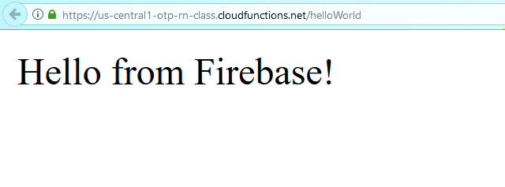
Functions

Slide 8
Functions
It looks like somehow the function that we uncomment in the previous section, successfully deployed in the Google server
We don’t do any configuration and yet that function is up and running

Slide 9
Functions
As we write each individual function, we’re going to see them appear as line items in the summary list

Slide 10
Logs
You can view the logs from Firebase Console to see the use/call of our function
It can be used as a logs if one day we encounter an error in running a function

Slide 11
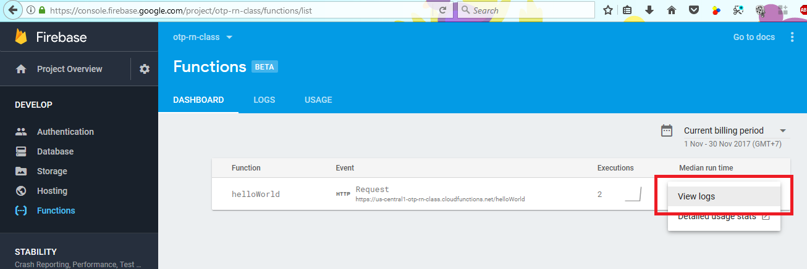
Logs

Slide 12
Logs
The one downside of this logs is that sometimes it takes a very long time to get those logs to appear on the screen
If you don’t see any logs yet, just wait 30 seconds to a minute and you’ll eventually see them appear on the screen

