Slide 1
Sanitizing User Inputs
Mobile Developer Fast Track

Slide 2
Introduction
In this section, we’ll make a code (function) to create a new firebase user whenever someone posts a phone number to this function

Slide 3
Introduction
But before that, we have to enable the user authentication in the Firebase Console
By default, whenever we create a new Firebase Project, the authentication feature is not turned on

Slide 4
Authentication
The authentication feature is what’s going to managing our user account for us
We’re not going to directly save the user into database
We’re going to set the user in the authentication service and store the user’s related data (if there’s any) in the database

Slide 5
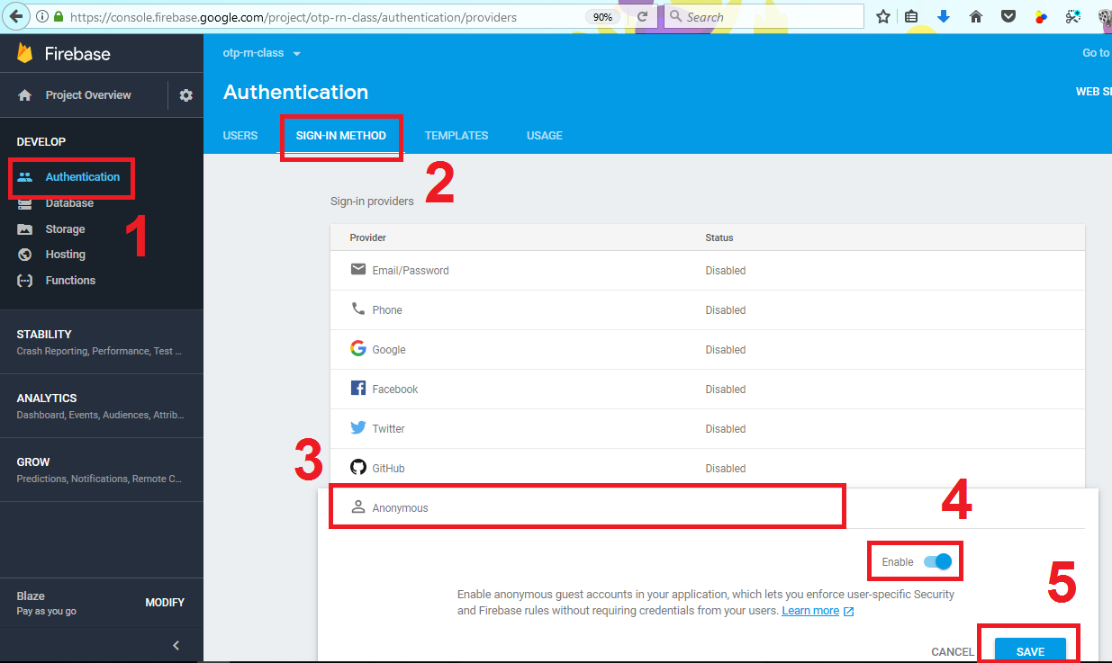
Enable Authentication

