Slide 1
Swipe Deck Props
Mobile Developer Fast Track

Slide 2
Introduction
Remember what kind of component that we’re going to make

Slide 3
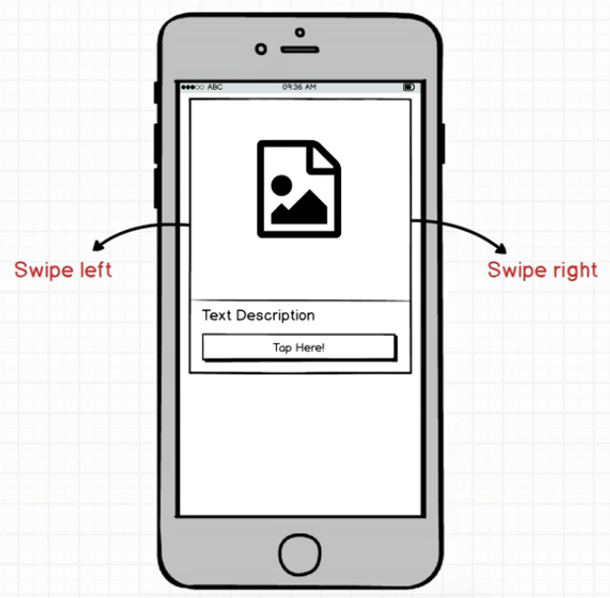
Introduction

Slide 4
Introduction
We want to have the ability to show multiple cards to the user
They should be able to swipe right or left

Slide 5
Introduction
Once they start swiping right or left, we want to rotate the card at the same time
In addition, as the user swipe far enough and hit some threshold, that card should automatically continue to drag out off the screen
And the next card should appear for the user to start dragging

Slide 6
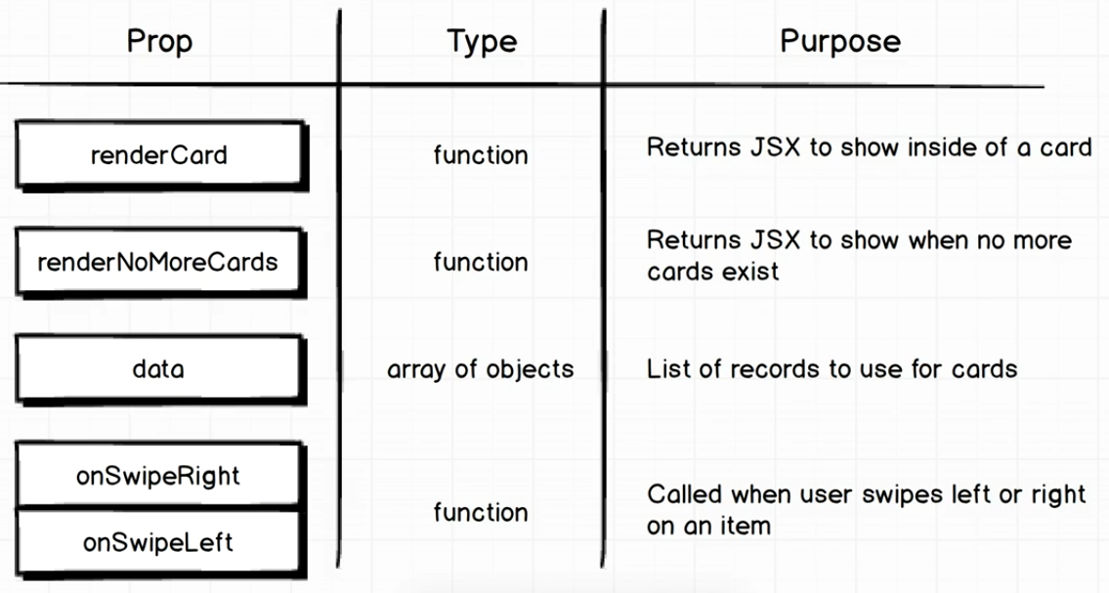
The Props

Slide 7
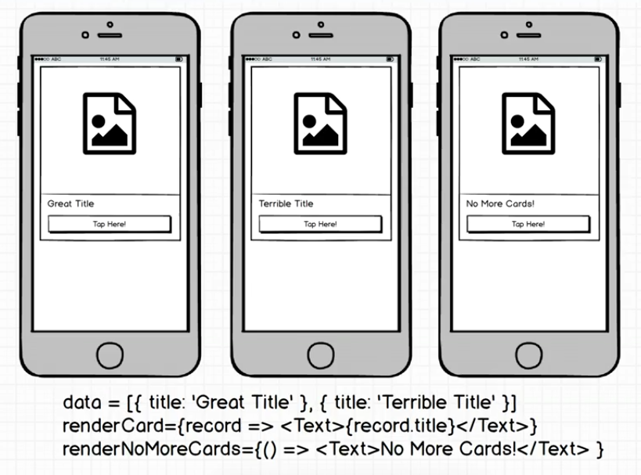
The Data

Slide 8
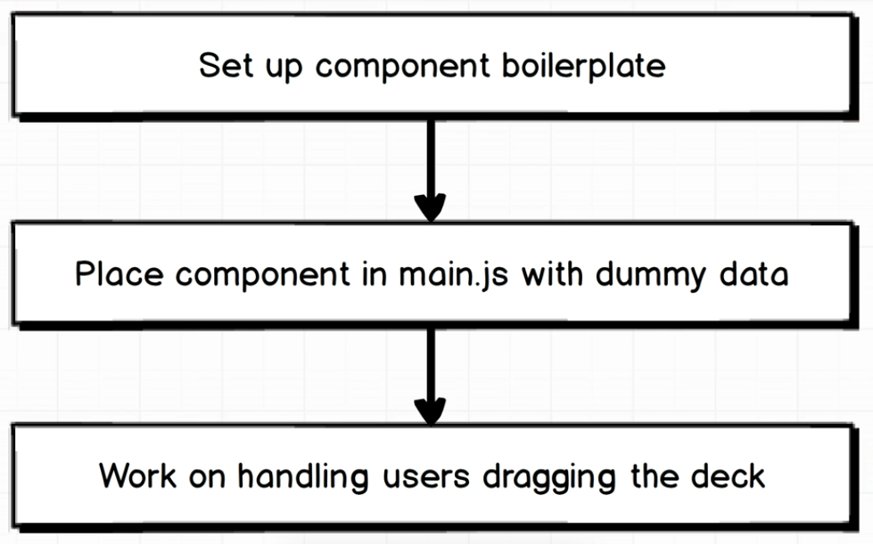
Boilerplate

