Slide 1
Software Needed
Mobile Developer Fast Track

Slide 2

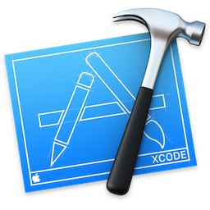


What We Need
React Native CLI

Slide 3
XCode
Apple’s Official IDE for building software for nearly ANY official Apple’s devices
Such as iPhone, iPad, iWatch, Mac laptop, etc
We’ll be using XCode to build our apps, package our code, and install them on a mobile devices

Slide 4
XCode
XCode also come bundled with the iOS simulator
It’s a tool used to run mobile apps directly on your desktop or laptop

Slide 5
HomeBrew
HomeBrew is a MacOSX dependency management program
It used just for one purpose, that is to install Node
Yes, you have to install a program just to install another program

Slide 6
NodeJS and NPM
Node and NPM are installed at a same time
Node is used to run Javascript outside the browser
NPM is used for installing and managing dependencies

Slide 7
Watchman
Watchman is a program developed by Facebook for exactly one purpose
That is watching files in a hard drive, and noticing when they get changed
Watchman will be used by React Native to automatically process changes to our code base, and update the mobile app that we’re working on

Slide 8
React Native Command Line Interface
The React Native Command Line Interface (RN CLI) has 2 purposes
The first is to generate a new React Native project
The second is to run the project in iOS or Android (devices or simulator)

