Slide 1
Installing Software
Mobile Developer Fast Track

Slide 2
Intro
This Guide will be based on the Getting Started page in React Native’s site
https://facebook.github.io/react-native/releases/next/docs/getting-started.html

Slide 3
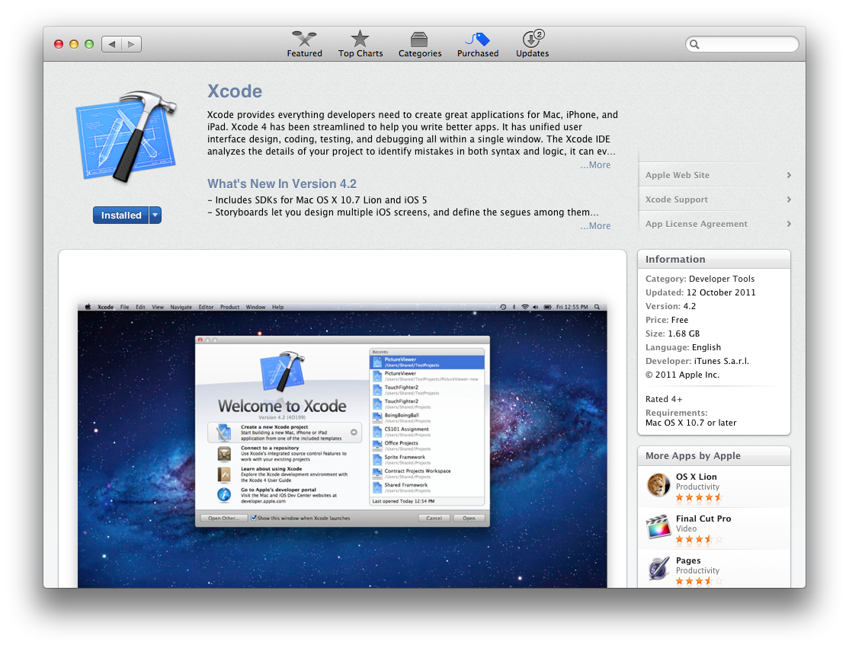
XCode
You can download the XCode from the App Store

Slide 4
XCode
Please note that even though you have installed XCode before, please make sure that you have installed the latest version of it
It may causing some error in the future if you have an older version of XCode

Slide 5
HomeBrew
Install HomeBrew from
https://brew.sh/
Copy and run this script on Terminal
/usr/bin/ruby -e “$(curl -fsSL https://raw.githubusercontent.com/Homebrew/install/master/install)“

Slide 6
HomeBrew
If you have HomeBrew already installed, you can update it by running this script on Terminal
brew update
You can check if you have successfully installed HomeBrew by running this script on Terminal :
brew --version

Slide 7
UPDATE
To install Node, you can download it from
https://nodejs.org/en/
Select the Latest Features (the “right” one)
After you installed it, you can skip the NodeJS installation section in the next slide

Slide 8
NodeJS
After successfully installing HomeBrew, now you can install Node
Run this script from terminal
brew install node
And you can check if the installing process is success by running this script on Terminal
node --version

Slide 9
Watchman
Install it by running the script
brew install watchman
Or if you’ve already installed it, you can update using
brew upgrade watchman

Slide 10
React Native Command Line Interface
And lastly, you can install RN CLI using this script and run it on Terminal :
npm install -g react-native-cli
If you have permission error, you can run :
sudo npm install -g react-native-cli

