Slide 1
Emulator Creation And System Variables
Mobile Developer Fast Track

Slide 2
Introduction
After successfully create the project, there are some steps that have to be done before we can run it in emulator

Slide 3
Setting Up The Emulator
Run Android Studio
Click “Open an existing Android Studio project”
Navigate to the folder where the app created before
Choose the “Android” folder inside your app’s folder
Click OK

Slide 4
Setting Up The Emulator
If there is an error or “Failed to Sync” error, just click the solution (Install missing ……) and follow the instruction
Do that until no more error occurred

Slide 5
Setting Up The Emulator
On Android Studio, click Tools → Android → AVD Manager
Click “Create Virtual Device”
Choose a device definition, anything you like
Select a system image, anything you like, but make sure to choose the one that have “with Google APIs”
Next you can change the device information, but that is optional
Last thing you can click “Finish”

Slide 6
Running The Emulator
You can run the emulator by pressing the “Play” button
That is the green triangle button in the “Actions” column
Wait until the emulator is fully running

Slide 7
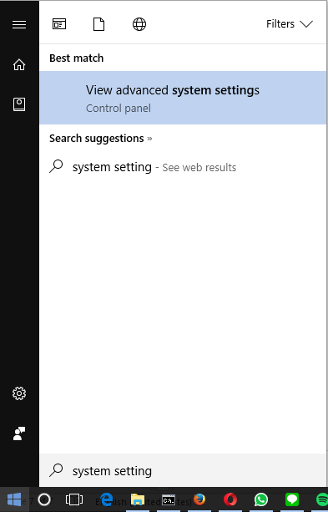
Add Environment Variables
Open Advanced System Settings by searching it in the start menu

Slide 8
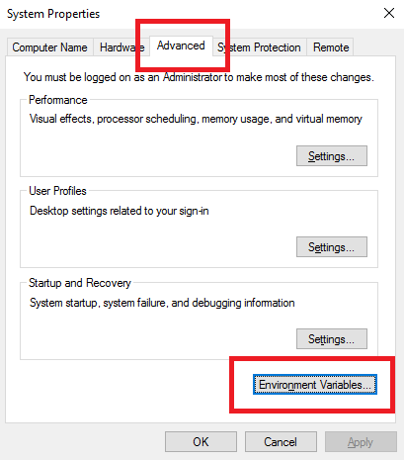
Add Environment Variables
Click the “Advanced” tab and then click the “Environments Variable” button

Slide 9
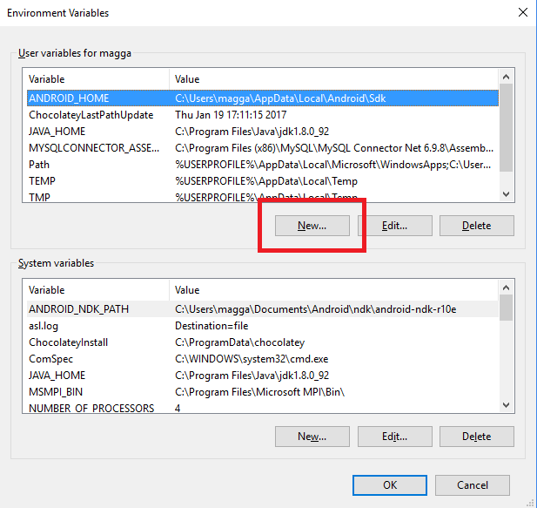
Add Environment Variables
You have to add 2 Environment Variables
The first one is JAVA_HOME
To do that, click New button

Slide 10
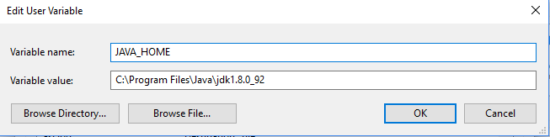
Add Environment Variables
Fill the “Variable Value” with the path of your JDK by clicking the “Browse Directory” button
Click OK

Slide 11
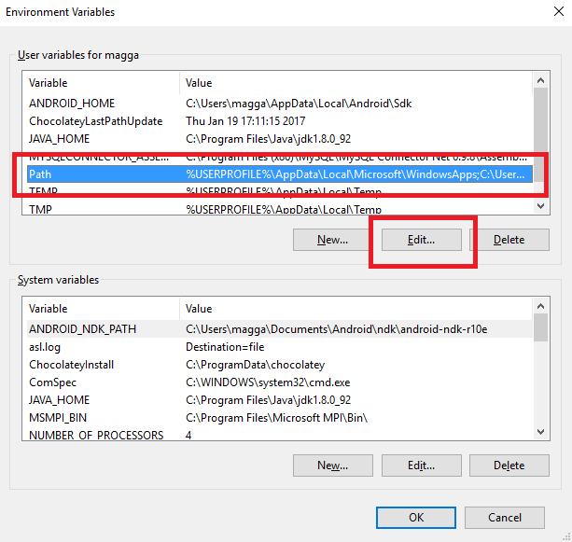
Add Environment Variables
The second one, add a value to the already-have “Path” variable
It can be done by clicking the “Path” variable and then click the “Edit” button

Slide 12
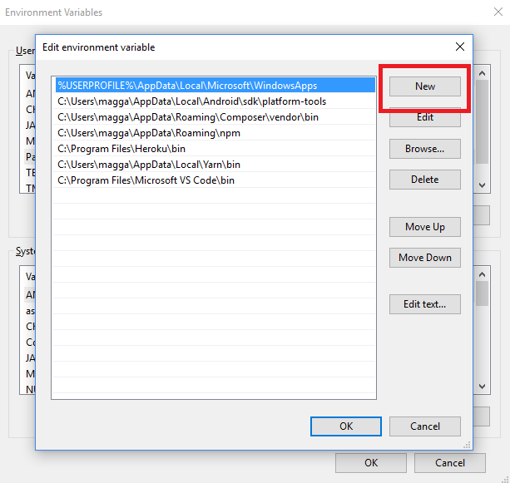
Add Environment Variables
Click “New”

Slide 13
Add Environment Variables
Add the path where your Android SDK’s “platform-tools” is saved
In this case, you can find it in
C:\Users\[YOUR_COMPUTER’S_USERNAME]\AppData\Local\Android\sdk\platform-tools

Slide 14
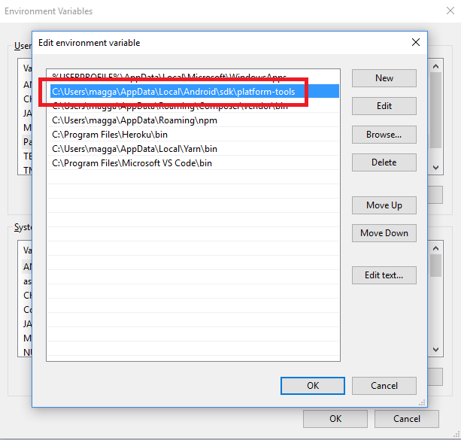
Add Environment Variables

Slide 15
Add Environment Variables
Click OK until the dialog disappeared

Slide 16
Finishing Up
Restart your command prompt
Open it again by running it as administrator
Change the directory to the folder where your project reside, in this case run
cd C:\Users\[YOUR_COMPUTER’S_USERNAME]\ReactNativeProject\[YOUR_PROJECT’S_NAME]

Slide 17
Finishing Up
To run your project, run the script
react-native run-android

